Slide 1

Flash-based Storage Management in
Cloud Computing Datacenter Infrastructures
Zhengyu Yang
Ph.D. Defense Presentation
Ph.D. Program Committee Members:
Dr. Ningfang Mi (Advisor), Dr. Yunsi Fei, Dr. Stratis Ioannidis
Dept. of Electrical & Computer Engineering,
Northeastern University, Boston, USA
July 31, 2018
Notes:
Good morning everyone, thank you for attending my phd defense presentation.

Slide 2


Data Creation
Data Creation Percentage
92%
(2016~2017)
Data Capacity
Catastrophe!
* IBM and SINTEF ICT
Notes:
Data creation is exploding.
92% of the world’s data was created in the last two years alone.
At the current rate, the data capacity catastrophe is no longer a joke.

Slide 3
Data Access
Patient Time
People can’t wait!
~ 30 sec
~ 15 sec
~ 5 sec
?
~ 1 sec
Baby Boomers
Generation X
Millennials
Generation Z
Generation ?
Notes:
Besides capacity, data accessibility is also a high demand.
Researchers found that people’s patient time are different across generations.
Generation Z, aka the iphone generation can no longer tolerate larger than 1 sec responses.
How about the future? VR, even 1 sec is too much.
So we conclude that people can’t wait!

Slide 4


Backend Infrastructure
Framework for Applications in Big Data Era (2017)
User
Web
It’s all about I/O!
Virtualized Servers
I/O
Data Process
Engine
I/O
I/O
I/O
SQL/NoSQL
Database
Machine Learning Analytics
Real Time Batch
Streaming
Notes:
Let’s take a look at the backend infrastructure of cloud computing and see what is the main bottleneck.
User applications send requests through the web, and the datacenter has thousands of virtualized servers to take care of these requests.
Inside these VMs, data process engines needs to talk with NoSQL databases, machine learning apps, and even real time batch streaming apps.
All these apps trigger huge amount of I/Os and storage I/O in fact is the bottleneck of the cloud computing.

Slide 5
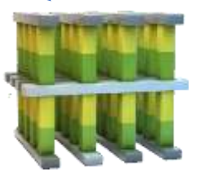
Storage Device Evolution
Write Latency and Cost Per GB Comparison
4.68$/GB
Gen. 3
All-Flash Datacenter
4.50$/GB
Gen. 2
SSD-HDD
Hybrid Datacenter
DRAM
nanosec
0.57$/GB
0.30$/GB
3D XPoint
10μs
Gen. 1
All-HDD
Datacenter
0.28$/GB
NVMe SSD
20μs
0.25$/GB
MLC SSD
750μs
TLC SSD
1125μs
HDD
10ms
Data Storage
(Block Operation)
CPU Cache
(Byte Operation)
Notes:
Let’s see what researchers have done to solve this.
Here’s the storage dev evolution roadmap.
Both price & IO perf are increasing from traditional HDD, multiple end of SSDs, to 3D Xpoint and DRAM.
We draw a line here.
1st gen datacenter is all-HDD. Since 2008, SSD is used as cache for SSD-HDD hybrid datacenter.
With the SSD price decreasing and SSD capacity increasing, All-Flash datacenter comes earlier than pp’s expectation.

Slide 6
Major Contributions
Investigate resource management of current SSD-HDD hybrid and all-flash storage systems.
Understand I/O patterns from different applications, and the bottleneck along the I/O stack of hypervisors.
Study write amplification, cost model of storage, cache/tier algorithms, and NVMe SSD device.
Develop and implement algorithms to improve I/O performance and reliability of both SSD-HDD hybrid storage and all-flash storage systems, as well as big data platforms.
Notes:
So, to sum up, we …

Slide 7
Outline
1. Background and Motivation
2. Review of Preliminary Work
3. I/O Stack Optimization: Hybrid Framework of NVMe SSDs
4. Store vs. Compute: Intermediate Data Caching Optimization
5. Conclusion and Future Work

Slide 8
Outline
1. Background and Motivation
2. Review of Preliminary Work
3. I/O Stack Optimization: Hybrid Framework of NVMe SSDs
4. Store vs. Compute: Intermediate Data Caching Optimization
5. Conclusion and Future Work

Slide 9
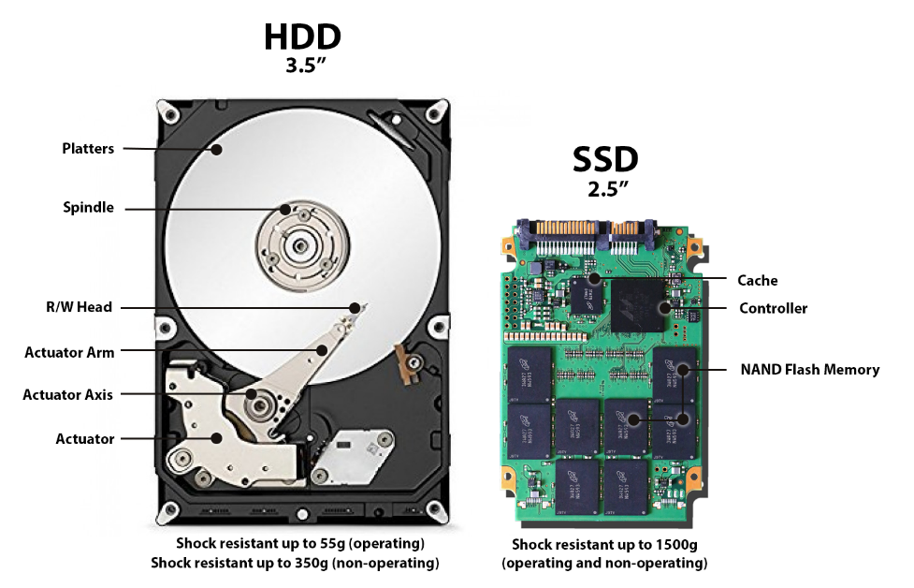
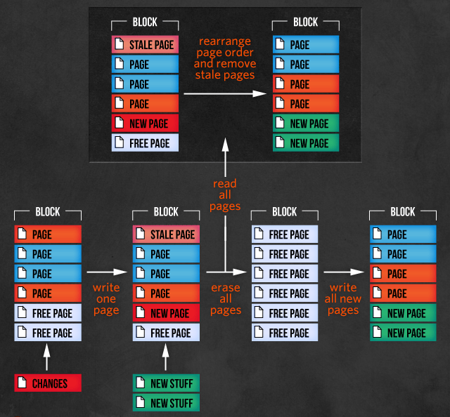
Background of Flash-based SSD
  Benefits
  No moving part
  Low latency
  High IOPS and I/O concurrency
  Low energy consumption
  Limitations
  Erase before rewrite
  (block granularity, ~3.5ms)
  Lifetime (~10,000 erase cycles)
____________________________________________________________
Picture: https://www.backblaze.com/blog/ssd-vs-hdd-future-of-storage
https://arstechnica.com/information-technology/2012/06/inside-the-ssd-revolution-how-solid-state-disks-really-work/3/
Notes:
First let’s take a look at SSD. Unlike HDD, SSD has no moving part, which makes it ….
However, it also has some limits. The biggest one is e-b-r.
The min unit to r/w is 4k page. Hwvr, to rewrite a page, u need to erase the entire block of this page which usually has 128 pages.
There comes WAF. Intuitively, the more random rewrite you have, the bigger WAF is.
Besides, SSD has limited lifetime. Avg each cell cannot be programmed for more than 10k times.

Slide 10
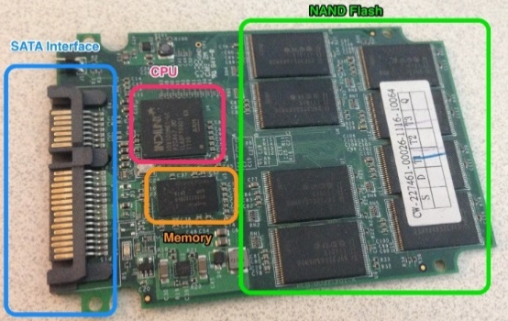
I/O Path and Write Amplification
Logical I/O
  Hardware-related factors:
  Log-structured FTL designs
  Garbage collection
  Overprovisioning
  Wear leveling
Physical I/O
$$WAF = \frac{PhysicalWriteIOAmount(Bytes)}{LogicalWriteIOAmount(Bytes\text{)} }$$
Notes:
Let’s see a detail example of SSD IO path and WAF.
OS generates logical I/Os and send them to device.
Inside SSD, there’s a key comp called FTL which maps log and phy I/Os.
As mentioned, phy may be greater than log.
We use WAF to reflect the ratio btw phy and log. The bigger the worse.
What affects WAF? First is HW.

Slide 11

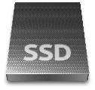

Deployment of SSDs
VM
VM
VM
VM
VM
VM
VM
VM
VM
VM
VM
VM
VM
VM
VM
VM
VM
VM
Hypervisor
Hypervisor
Hypervisor
RAM
RAM
RAM
SSD
SSD
SSD
Duplication
No Duplication
HDD
HDD
Storage Pool
Storage Pool
Storage Pool
SSD Cache
SSD-HDD Tier
All-Flash Tiers
Gen 2
Gen 3
Notes:
Deployment of SSD also affects WAF.
We see how SSDs are deployed in both 2 and 3 gen DC.
VMs are hosted by hyper. They share RAM.
SSDs can be used as a cache of HDD or a tier in a hybrid system.
In gen3, we have all-flash tiers and each tier has diff spec like perf or cap.
Notice that cache has dup, tier had no dup.

Slide 12

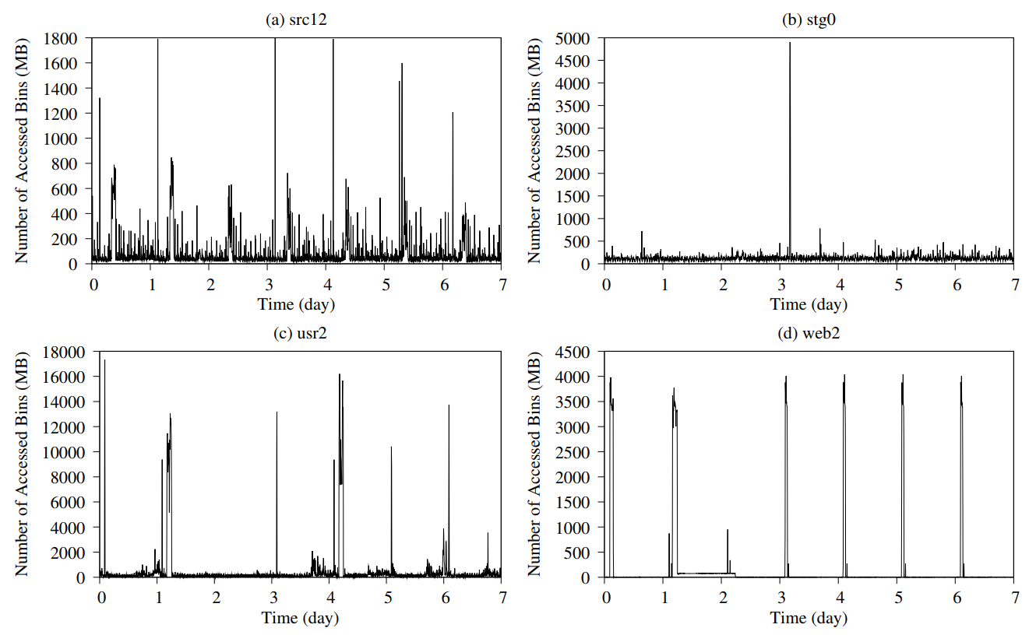
I/O Pattern Study
[Obs.1] Different applications have different I/O patterns.
[Obs.2] Application’s I/O pattern varies during runtime.
Online I/O Management
______________________________________________________________________________________
* Picture: "Improving Flash Resource Utilization at Minimal Management Cost in Virtualized Flash-based Storage Systems", IEEE Transactions on Cloud Computing, vol. 5, no. 3, pp. 537-549, July-Sept. 1 2017.
Notes:
Beside HW and deployment, IO pattern is also important.
We study MSR traces. We have two obvs.
Motivate us to develop online IO manager to improve both perf and rel.

Slide 13
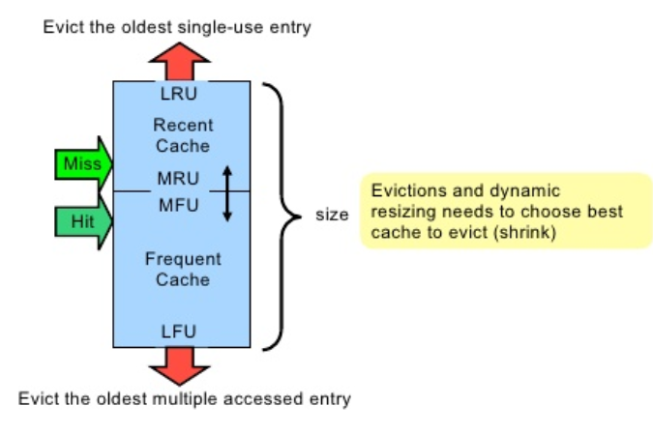

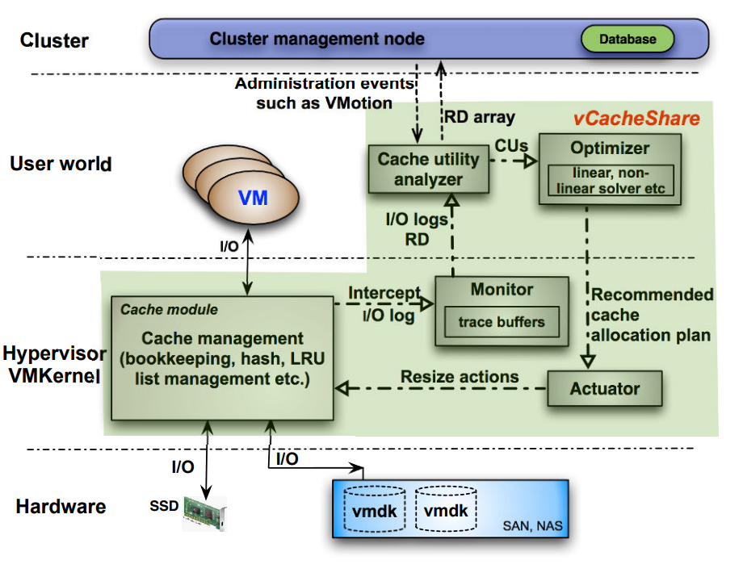
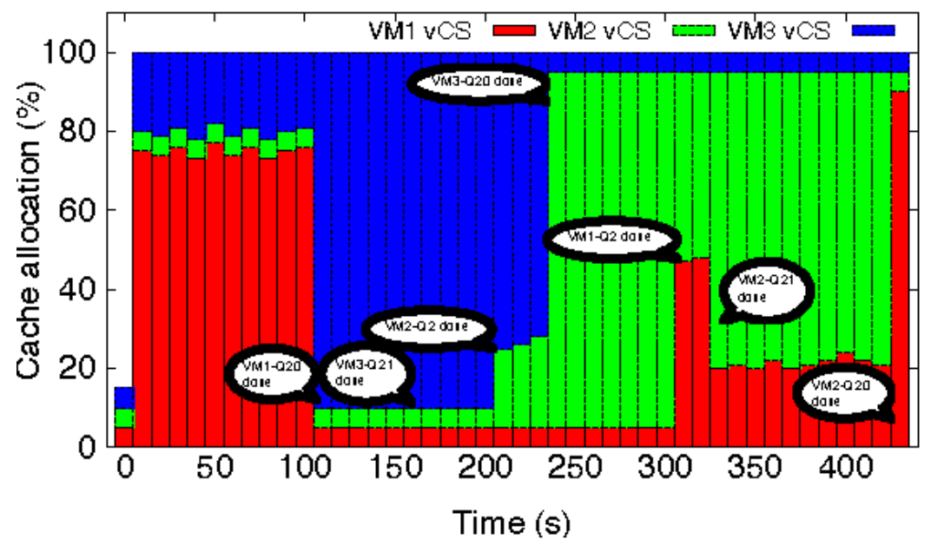
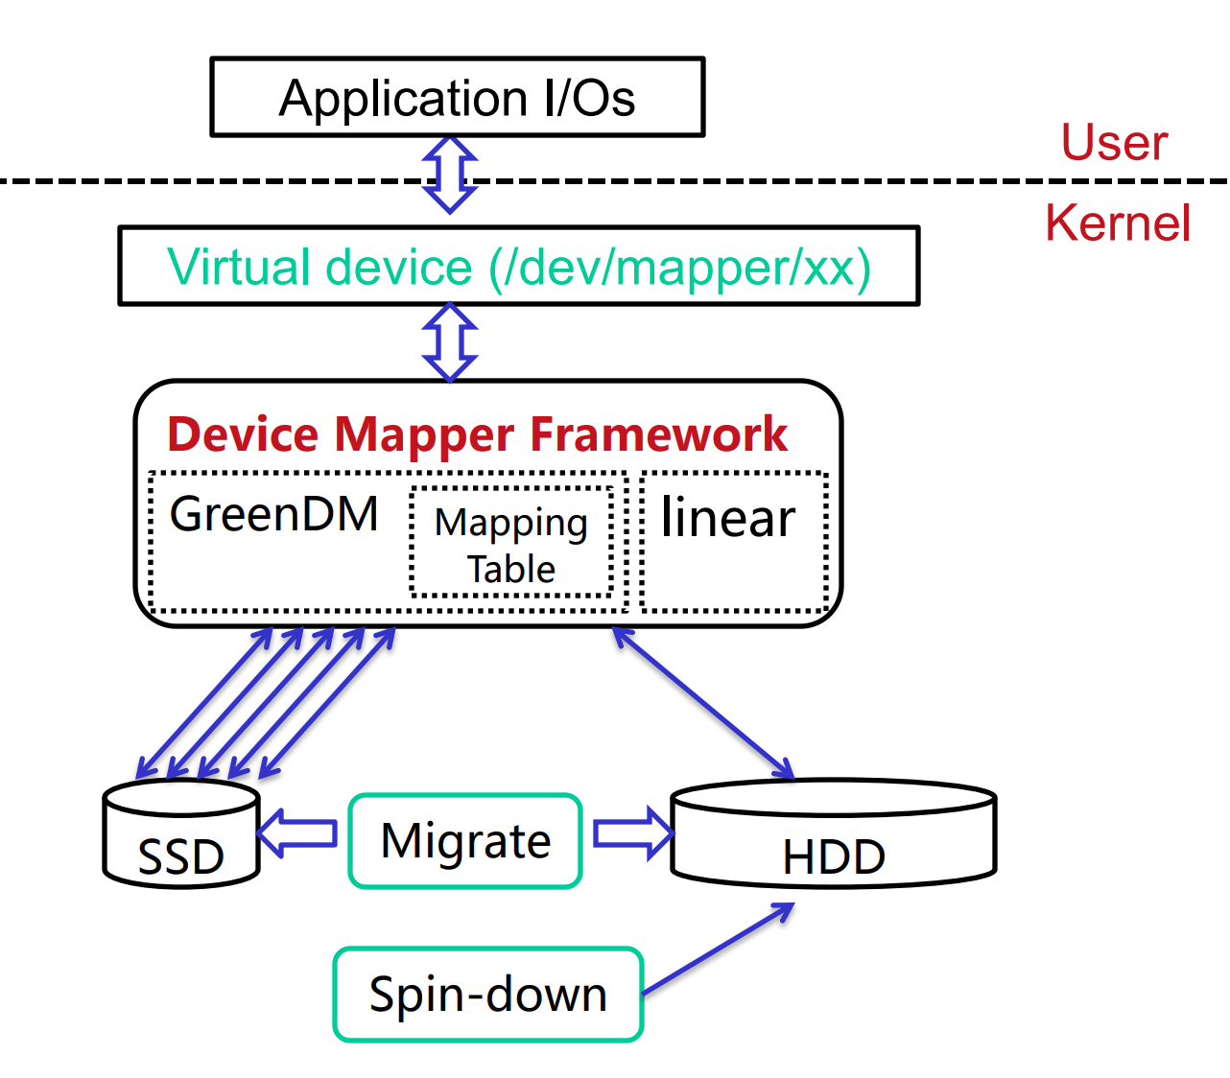
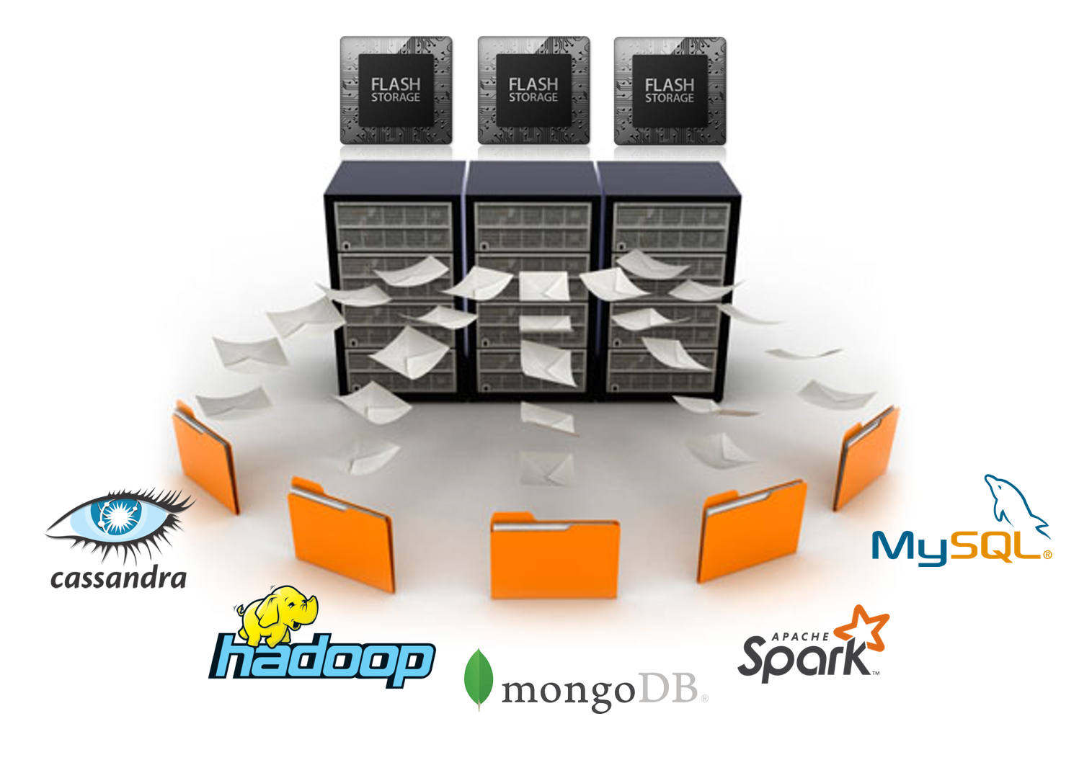
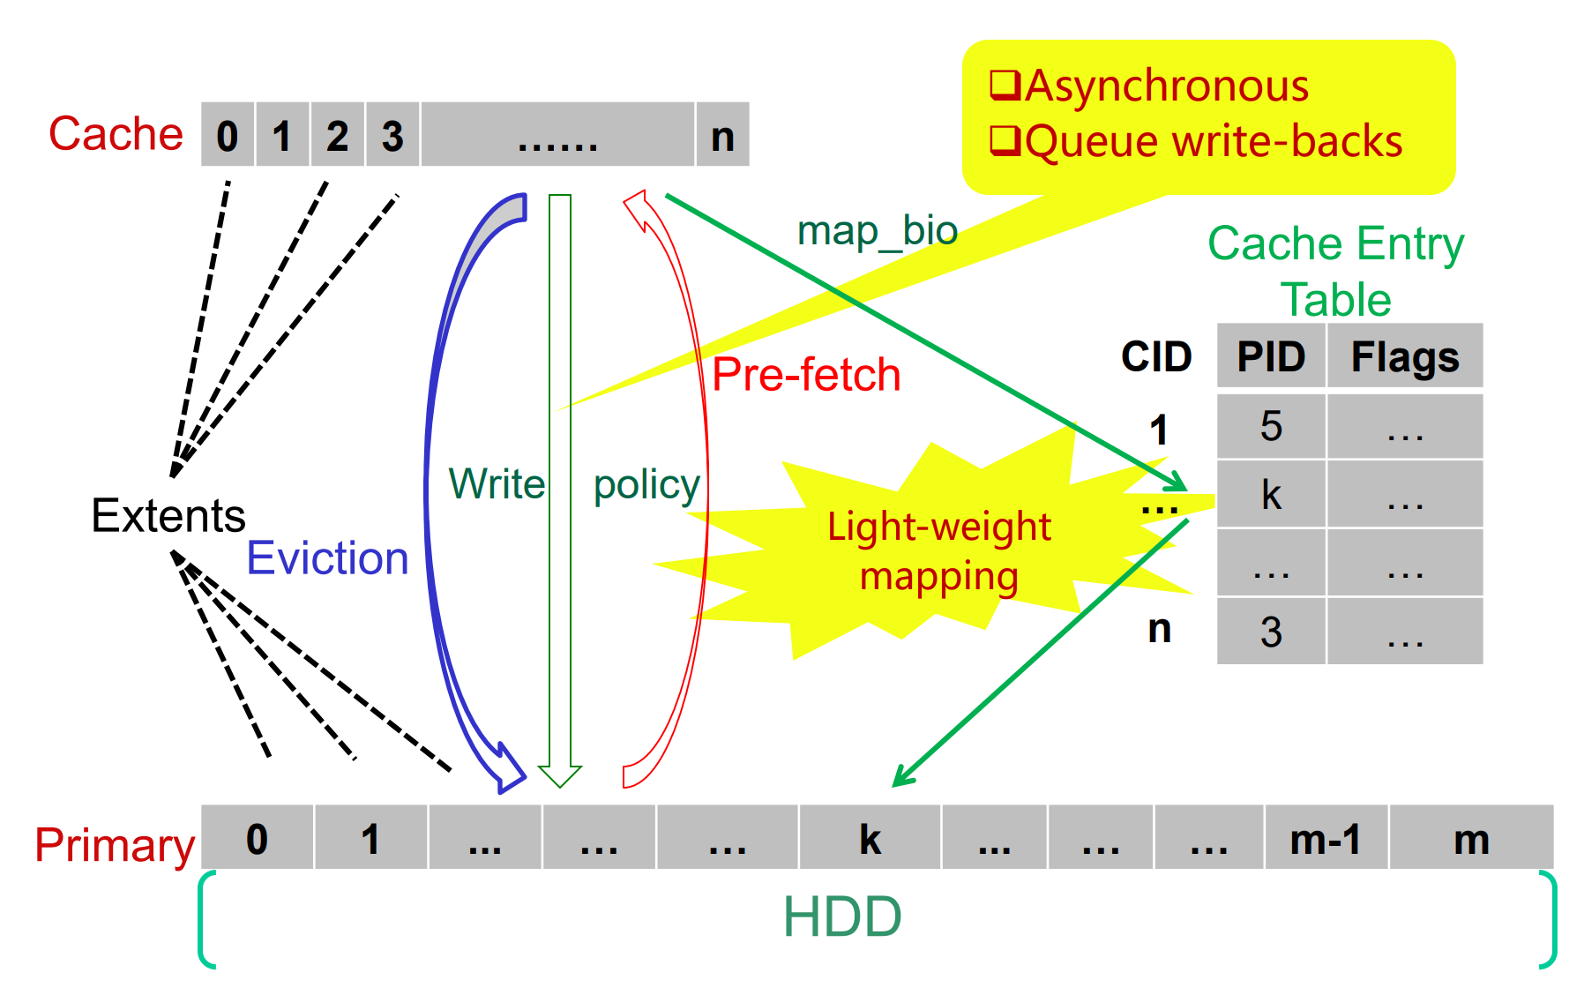
Related Work
 | Traditional caching algorithm is not suitable: => Flash devices do not have huge speed gap | Traditional caching algorithm has two copies: => too expensive for SSDs to have duplications
[CAR, CART, ARC]
≠
Cache
Backend
 | Only treat SSD as a read-only tier and bypass write IOs to the disk => degrades the overall hit ratio | Not consider specialties of SSDs.
[F. Meng, vCacheShare]
Read-only
SSD Tier
Rd./Wrt. Performance Spatial Capacity
 | Not focus on write amplification of SSD (NVMe) in terms of sequential ratio | Not deploy long-term workload Only focuses on per I/O
[Z. Li, costModel]
≠
Write Amplification vs Seq Ratio
Per I/O
Long-term Workload
Notes:
Can we simply use existing algorithms to conduct online manage?
Let’s some related work.
1. trad caching not suit, because unlike all HDD SSD, all=flash do not have huge gap.
2. How abt tiering? vCS is famous by Vmware
3. lastly, reliability, cost model. Hwver no WAF and Seq% which is important. Per IO

Slide 14
Research Focus
SSD’s Benefits | SSD’s Issues
High Throughput | Expensive
Low I/O Latency | Limited Write Cycle
Low Energy Consumption | No In-place Updates
Cause
Performance | Slow Down due to Write Amplification
Reliability | Data Loss due to Endurance
Motivate
Gen 2 SSD-HDD Hybrid |  | Gen 3 All-Flash |  | Big Data Platform
Performance | Reliability | Performance | Reliability | Performance | Reliability
GREM | AutoReplica | AutoTiering | minTCO | H-NVMe | AdaptCache
Notes:
Since we can’t directly use exiting work, and SSD has limitations degrades to perf and reliability.
We are motivated to propose both pef and rel solutions for gen2/3 and big data plt.
Next slide shows details

Slide 15
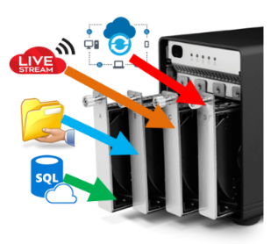
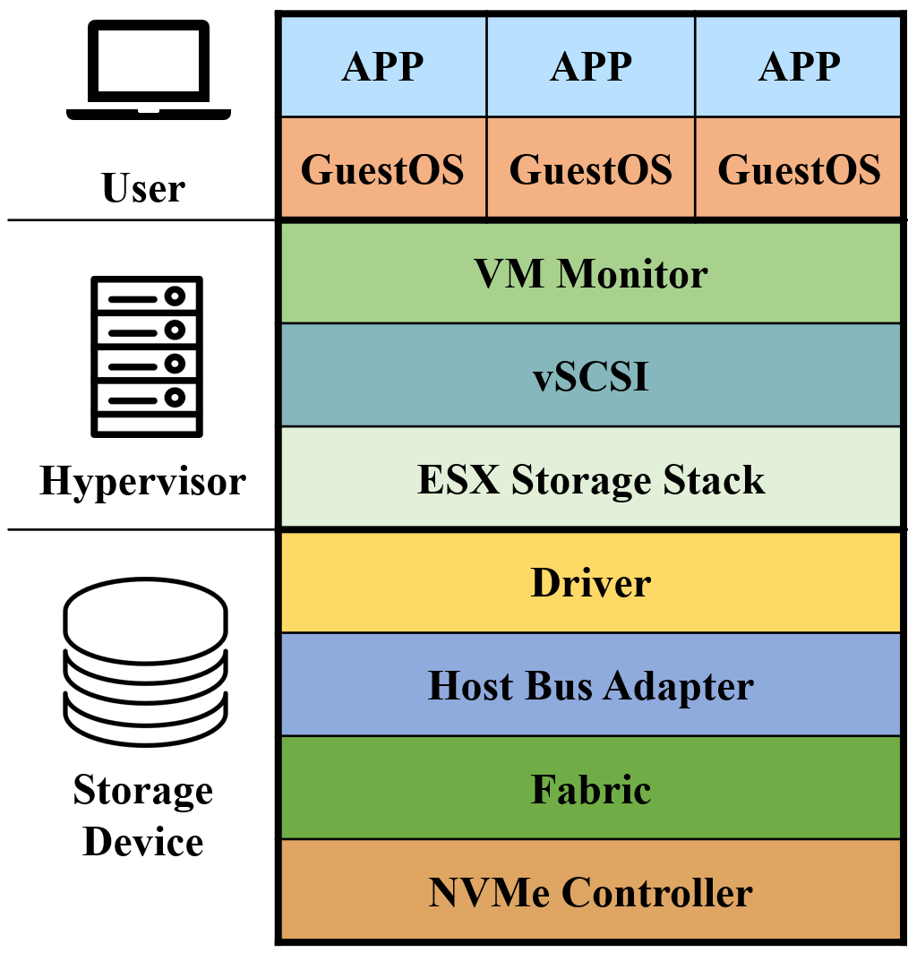
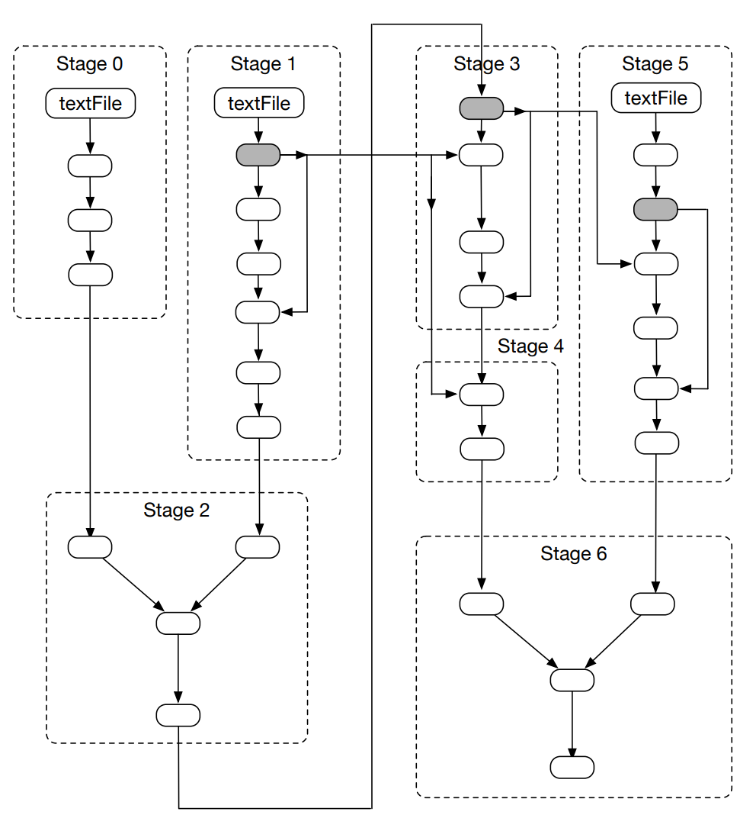
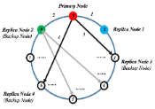

Dissertation Contributions
Hybrid Datacenter
SSD-HDD Caching
GREM (IPCCC’16)
Replication
AutoReplica (IPCCC-CPS’16, SCPE’17)
All-Flash Datacenter
All-Flash Tiering
AutoTiering (IPCCC’17)
Endurance and Cost
minTCO (CloudCom’16)
Big Data Platform
I/O Stack
H-NVMe (IPCCC’17)
Store vs. Compute
AdaptCache (IEEE Cloud’18)
Preliminary
Preliminary
Preliminary
Preliminary
Notes:
There are 6 major proj Ive done dur my phd study.
First 4 prlmnr wk are include in my previous propose.
Last 2 after propose
First briefly recap, Then focus

Slide 16
Outline
1. Background and Motivation
2. Review of Preliminary Work
3. I/O Stack Optimization: Hybrid Framework of NVMe SSDs
4. Store vs. Compute: Intermediate Data Caching Optimization
5. Conclusion and Future Work

Slide 17
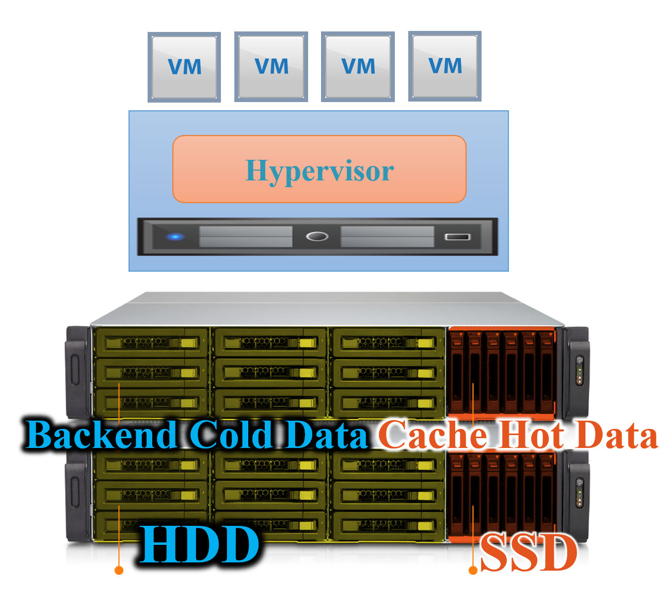
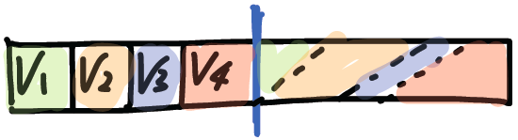
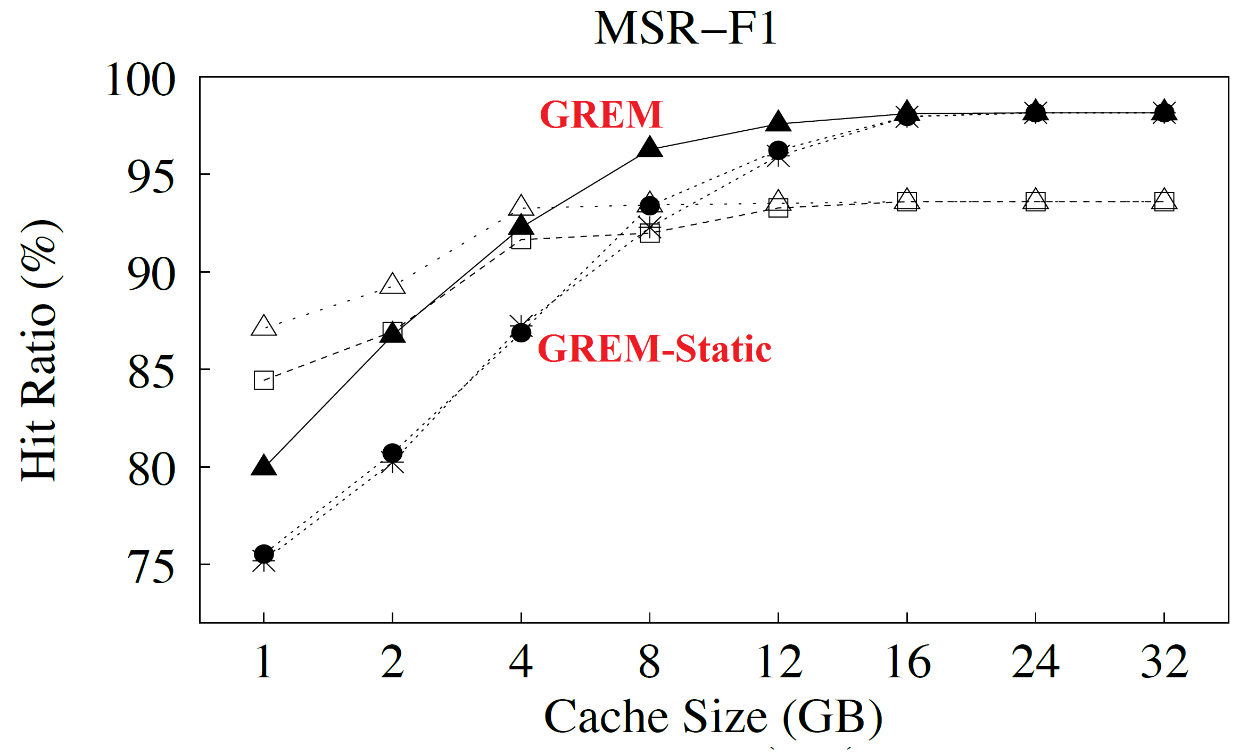
[1] SSD-HDD Caching: GREM
How to assign space for each VM?
Long-Term Zone
Short-Term Zone
  [Step1] Flexibly divide sizes of two zones by leveraging the feedbacks from cache performance and workload changes.
GREM “GREM: Dynamic SSD Resource Allocation in Virtualized Storage Systems with Heterogeneous IO Workloads”, 35th IEEE International Performance Computing and Communications Conference, 2016.
  [Step2] Dynamically adjust the reservation for each VM in long-term zone based on IO pattern history.
Higher Hit Ratio
Better Isolation
Notes:
1st work GREM published in IPCCC16. We try to answer.
We div SSD into two zones one for per iso, other for absorbing spike.
Further auto adjust …

Slide 18
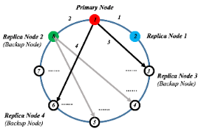
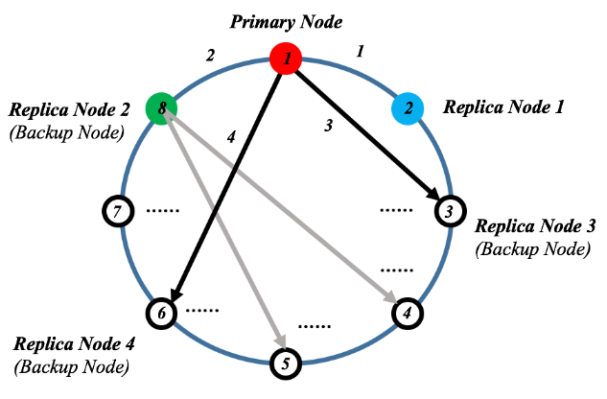
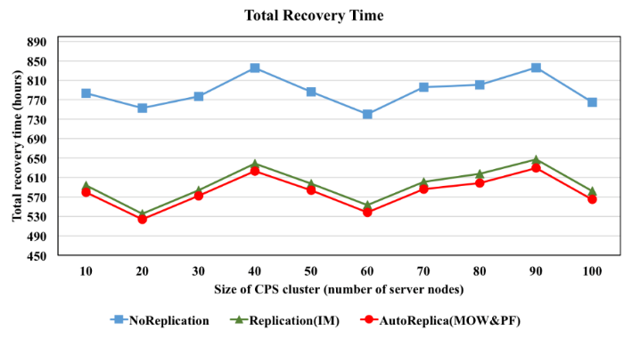
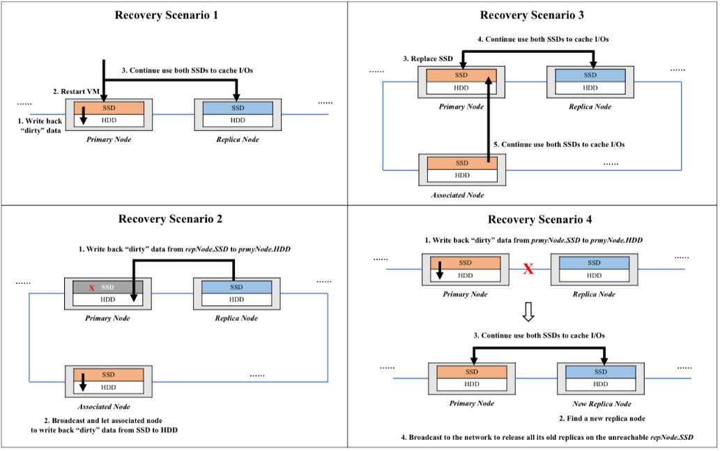
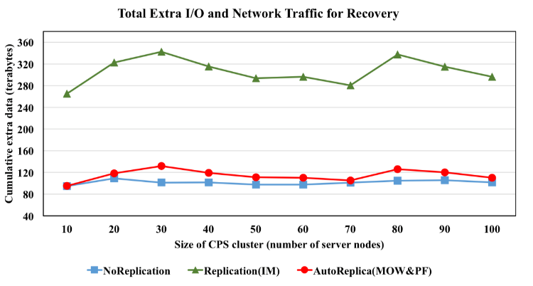
[2] Replication: AutoReplica
How to replicate datasets among clusters while not significantly downgrade system performance?
SSD = Local Cache + Remote Replication
SLA => Replication Destination
AutoReplica [1] “AutoReplica:Automatic Data Replica Manager in Distributed Caching and Data Processing Systems”, 1st IEEE International Workshop on Communication, Computing, and Networking in Cyber Physical Systems, 2016.
[2] “Automatic and Scalable Data Replication Manager in Distributed Computation and Storage Infrastructure of Cyber-Physical Systems”, Scalable Computing: Practice and Experience, Special Issue on Communication, Computing, and Networking in Cyber-Physical Systems, 2017.
Recovery is faster
Support different scenarios
Overhead is lower
Notes:
2nd work is a replication solution for hybrid system.
How to replace but not downgrade perf too much?
We use SSD as local cache and the place for remote neigh’s replication.
It also auto structure the ring network to determine replication destiny based on SLA.
We support… Revr is fast…

Slide 19
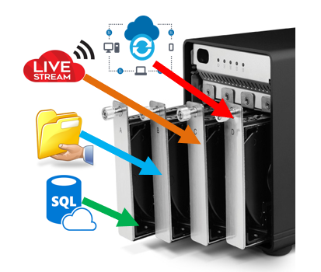
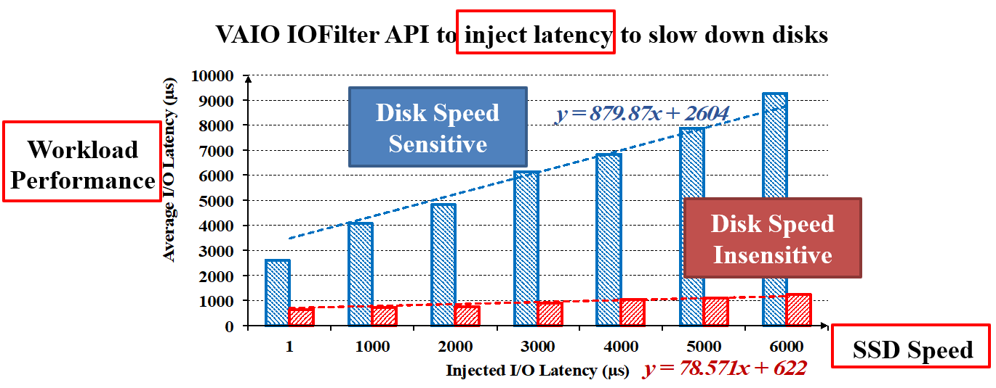
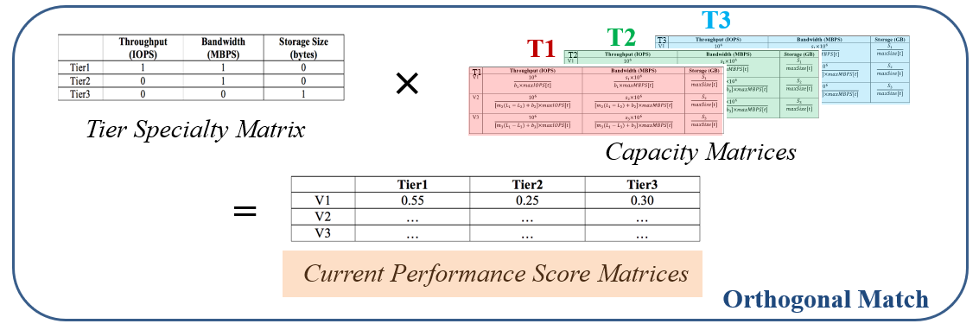
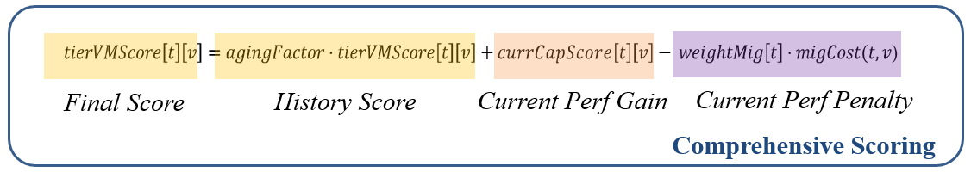
[3] All-Flash Tier: AutoTiering
How to match workloads with SSD tiers?
AutoTiering “AutoTiering: Automatic Data Placement Manager in Multi-Tier All-Flash Datacenter”, 36th IEEE International Performance Computing and Communications Conference, 2017.
Performance Tier
Samsung PM953 (NVMe)
Middle Tier
Samsung PM1633 (SAS)
Capacity Tier
Samsung PM863 (SATA)
Different Sensitivity
Higher Throughput
Orthogonal Match
Higher Bandwidth
Comprehensive Scoring
Lower Latency
Less Migrations
Notes:
Now we move to all-flash DC. 3rd proj is tiering solution. IPCCC17.
Match wk with SSD tier.
Our alg is based on obs that diff app have dff sen on disk speed.
Based on this we prop OM to match wk and tier.
To avoid migration too much, we consider his curr and mig cost.
Our alg can …

Slide 20
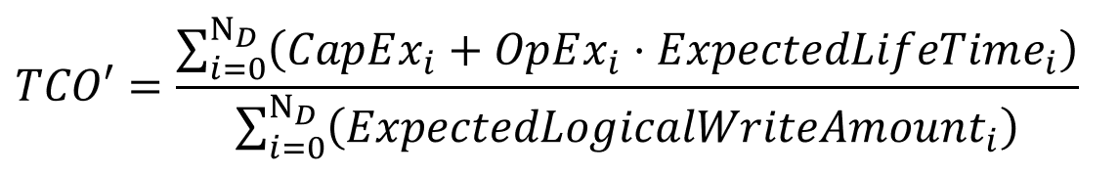


[4] Datacenter Cost: minTCO
How to model TCO to reflect write amplification and endurance?
?
$
$ per served logical byte
Bytes
minTCO ”A Fresh Perspective on Total Cost of Ownership Models for Flash Storage in Datacenters”, 8th IEEE International Conference on Cloud Computing Technology and Science. 2016. .
$$ExpectedLifeTime_{i}={AccumulatedWorkTime}_{i}+{ExpectedWorkTime}_{i}$$
$$\frac{{TotalWriteLimit}_{i}−{CurrentWriteCount}_{i}}{{PhysicalWriteRate}_{i}}$$
${LogicalWriteRate}_{i}⋅{WAF}_{i}(SequentialRatio_{i}$)
Linear
WAF
Polynomial
Lower
TCO
Better
TP Util %
Better
Cap Util %
Better
Balance
Notes:
- Last prlmnr work a dispatcher based on cost model. Published by CC16.
Industry care about cost model predict long term $.
- Our TCO model is def as sum of SSD pur and matin cost div by exp log wr amt.
Phy mean is per dollar, how many log GB you can serve.
Intuitively, a naïve disp will end up with big WAF and big TCO.
We don’t know ELF, we breakdown and find the only thing we don’t know phy
We can bridge log and phy by WAF
We conduct direct measurement by using SS int tool
WAF can be regressed as …

Slide 21
Outline
1. Background and Motivation
2. Review of Preliminary Work
3. I/O Stack Optimization: Hybrid Framework of NVMe SSDs
4. Store vs. Compute: Intermediate Data Caching Optimization
5. Conclusion and Future Work

Slide 22
I/O Stack: H-NVMe
NVMe has 64K queues.
Current I/O stack is not lock-free.
Big waste of NVMe queues.
How to fully utilize NVMe’s parallelism in today’s virtualized systems?
H-NVMe “H-NVMe: A Hybrid Framework of NVMe-based Storage System in Cloud Computing Environment", 36th IEEE International Performance Computing and Communications Conference, 2017. Best Paper Award.

Slide 23
Storage Device Evolution
Write Latency and Cost Per GB Comparison
4.68$/GB
4.50$/GB
DRAM
nanosec
0.57$/GB
0.30$/GB
3D XPoint
10μs
0.28$/GB
NVMe SSD
20μs
On your mark!
0.25$/GB
MLC SSD
750μs
TLC SSD
1125μs
HDD
10ms
Data Storage
CPU Cache
Notes:
Recall the roadmap.
We see a sweet spot here, the NVMe SSD.
High perf and affordable costs make it pop in these days datacenter.
Why? And what is NVMe?

Slide 24
What is NVMe?
Max 600MB/s
AHCi
SATA Cable
SATA SSD
Max > 4GB/s
NVMe
PCIe Bus
Server Motherboard
Fully utilized?
NVMe SSD
Solution | AHCi | NVMe
Full Name | Advance Host Controller Interface | Non-Volatile Memory Express
Interface | SATA | PCIe
Queue # | 1 | Up to 64K
Commands # / Queue | Up to 32 | Up to 64K
Bandwidth | 600MB/s | 4GB/s
Notes:
Traditionally …
Do we really fully utilize this?

Slide 25




How is NVMe SSD deployed?
I/Os Stack of VMware ESXi’s Implementation
User | APP | APP | APP
 | GuestOS | GuestOS | GuestOS
Hypervisor | VM Monitor
 | vSCSI
 | ESX Storage Stack
Storage Device | Driver
 | Host Bus Adapter
 | Fabric
 | NVMe Controller
VM
VM
VM
DRAM
Storage Pool
Notes:
To answer this question, take look at how it is deployed.
Here is a soft/hardware stack of a pop platform VMware ESXi.
3 layers.
VM run app, hosted by hyper, DRAM to cache, NVMe as backend storage.

Slide 26
What is the problem?
I/Os Stack of VMware ESXi’s Implementation
User | APP | APP | APP
 | GuestOS | GuestOS | GuestOS | [1] World Queue
Hypervisor | VM Monitor
 | vSCSI
 | ESX Storage Stack |  |  | [2] Adapter Queue
Storage Device | Driver
 | Host Bus Adapter
 | Fabric
 | NVMe Controller
IOServ
[3] Device Queue
Up to 64K queues
Notes:
What’s the problem?
There are lots of intermediate queues.
To simplify the problem, we only show major queues, in fact more.

Slide 27
What is the problem?
I/Os Stack of VMware ESXi’s Implementation
User | APP | APP | APP
 | GuestOS | GuestOS | GuestOS | [1] World Queue
Hypervisor | VM Monitor
 | vSCSI
 | ESX Storage Stack |  |  | [2] Adapter Queue
Storage Device | Driver
 | Host Bus Adapter
 | Fabric
 | NVMe Controller
IOServ
[3] Device Queue
Up to 64K queues
Notes:
IO generated from VM

Slide 28
What is the problem?
I/Os Stack of VMware ESXi’s Implementation
User | APP | APP | APP
 | GuestOS | GuestOS | GuestOS | [1] World Queue
Hypervisor | VM Monitor
 | vSCSI
 | ESX Storage Stack |  |  | [2] Adapter Queue
Storage Device | Driver
 | Host Bus Adapter
 | Fabric
 | NVMe Controller
Consolidation
IOServ
[3] Device Queue
Up to 64K queues
Notes:
Consolidate to adapter queue

Slide 29
What is the problem?
I/Os Stack of VMware ESXi’s Implementation
User | APP | APP | APP
 | GuestOS | GuestOS | GuestOS | [1] World Queue
Hypervisor | VM Monitor
 | vSCSI
 | ESX Storage Stack |  |  | [2] Adapter Queue
Storage Device | Driver
 | Host Bus Adapter
 | Fabric
 | NVMe Controller
Consolidation
IOServ
[3] Device Queue
Up to 64K queues
Notes:
IOServ in NVMe driver strives to dispatch them into queues in NVMs device

Slide 30
What is the problem?
I/Os Stack of VMware ESXi’s Implementation
User | APP | APP | APP
 | GuestOS | GuestOS | GuestOS | [1] World Queue
Hypervisor | VM Monitor
 | vSCSI
 | ESX Storage Stack |  |  | [2] Adapter Queue
Storage Device | Driver
 | Host Bus Adapter
 | Fabric
 | NVMe Controller
Consolidation
IOServ
[3] Device Queue
Up to 64K queues
Notes:
One by one

Slide 31
What is the problem?
I/Os Stack of VMware ESXi’s Implementation
User | APP | APP | APP
 | GuestOS | GuestOS | GuestOS | [1] World Queue
Hypervisor | VM Monitor
 | vSCSI
 | ESX Storage Stack |  |  | [2] Adapter Queue
Storage Device | Driver
 | Host Bus Adapter
 | Fabric
 | NVMe Controller
Consolidation
IOServ
[3] Device Queue
Up to 64K queues

Slide 32
What is the problem?
I/Os Stack of VMware ESXi’s Implementation
User | APP | APP | APP
 | GuestOS | GuestOS | GuestOS | [1] World Queue
Hypervisor | VM Monitor
 | vSCSI
 | ESX Storage Stack |  |  | [2] Adapter Queue
Storage Device | Driver
 | Host Bus Adapter
 | Fabric
 | NVMe Controller
IOServ
[3] Device Queue
Up to 64K queues

Slide 33
What is the problem?
I/Os Stack of VMware ESXi’s Implementation
User | APP | APP | APP
 | GuestOS | GuestOS | GuestOS | [1] World Queue
Hypervisor | VM Monitor
 | vSCSI
 | ESX Storage Stack |  |  | [2] Adapter Queue
Storage Device | Driver
 | Host Bus Adapter
 | Fabric
 | NVMe Controller
Locked
Wait for completion
IOServ
[3] Device Queue
Up to 64K queues
Notes:
Adapter queue will be locked, and it starts to wait for completion.
So far so good, right? But…

Slide 34
What is the problem?
I/Os Stack of VMware ESXi’s Implementation
User | APP | APP | APP
 | GuestOS | GuestOS | GuestOS | [1] World Queue
Hypervisor | VM Monitor
 | vSCSI
 | ESX Storage Stack |  |  | [2] Adapter Queue
Storage Device | Driver
 | Host Bus Adapter
 | Fabric
 | NVMe Controller
Locked
Wait for completion
IOServ
[3] Device Queue
Up to 64K queues
Notes:
Now we have more new IOS coming

Slide 35
What is the problem?
I/Os Stack of VMware ESXi’s Implementation
User | APP | APP | APP
 | GuestOS | GuestOS | GuestOS | [1] World Queue
Hypervisor | VM Monitor
 | vSCSI
 | ESX Storage Stack |  |  | [2] Adapter Queue
Storage Device | Driver
 | Host Bus Adapter
 | Fabric
 | NVMe Controller
Consolidation
Locked
Wait for completion
Blocked
Send Completion signal
IOServ
[3] Device Queue
Finished
Wasted
Up to 64K queues
Notes:
Again, merge, then Oops, blocked, and 64k queues are wasted.
Until finished and completion signal is sent. Unlock.

Slide 36
What is the problem?
I/Os Stack of VMware ESXi’s Implementation
User | APP | APP | APP
 | GuestOS | GuestOS | GuestOS | [1] World Queue
Hypervisor | VM Monitor
 | vSCSI
 | ESX Storage Stack |  |  | [2] Adapter Queue
Storage Device | Driver
 | Host Bus Adapter
 | Fabric
 | NVMe Controller
Unlocked
IOServ
[3] Device Queue
Up to 64K queues
Notes:
Now IOServ can start to dispatch.

Slide 37
What is the problem?
I/Os Stack of VMware ESXi’s Implementation
User | APP | APP | APP
 | GuestOS | GuestOS | GuestOS | [1] World Queue
Hypervisor | VM Monitor
 | vSCSI
 | ESX Storage Stack |  |  | [2] Adapter Queue
Storage Device | Driver
 | Host Bus Adapter
 | Fabric
 | NVMe Controller
IOServ
[3] Device Queue
Up to 64K queues
Notes:
There are lots of intermediate queues

Slide 38

Problems and Implications
Problem 1: Too many intermediate queues.
=> Redundant consolidation and dispatching operations.
Improve these queues?
Problem 2: Queue operations are not lock-free.
=> Waiting for completions is a big waste of time.
Lock-free?
Problem 3: There is only one “IOServ” dispatcher.
=> Cannot fully utilize up-to 64K queues in NVMe.
More “IOServ”s?
Notes:
So to sum up, there are 3 problems in the current architecture.

Slide 39
Design Goals
Goals:
  Improve I/O stack by removing locks
  Fully utilize up-to 64K queues in NVMe disk
Implementation Focus:
  VMware ESXi 6.0.0 (Kernel and IOFilter)
  Samsung NVMe driver
Approaches:
  Compatible: Parallel Queue Mode
  Aggressive: Direct Access Mode

Slide 40
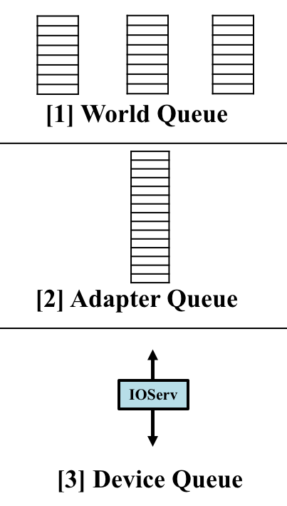
H-NVMe: Two-mode Framework Design
Current
New Mode 1
New Mode 2
Original I/O Stack
APIs
Empty
This Queue
Full Control
1. Empty the queue
1. Attach IOFilter
2. Customized device queues
2. Forward to NVMe
3. Multiple IOServs
3. Multiple IOServs
Notes:
Here is an overview of our two modes, comparing with the original design.
We have limited control of hypervisor thru APIs, but we have full control of the NVMe driver.
Thus, ur 1st idea is to empty adapter queue by taking everything from it to our customized device queue, and also multiple IOServs to fully utilize NVMe queues.
The second mode is more aggressive. We bypass all these queues and directly bridge VM Ios with device queues and multi IOServs.
VAIO (vSphere APIs for IOFiltering)
Solution: H-NVMe offers two modes to deploy VMs:
[Parallel Queue Mode] Increase parallelism Enable lock-free operations by forwarding jobs from the Adapter Queue to the our proposed enhanced subqueues in the driver. A generalized solution, relatively straightforward to implement.
[Direct Access Mode] allows trusted applications with VAIO IOFilter attached to their user VMDKs to directly access NVMe SSDs and bypass the entire I/O stack in the hypervisor layer to further ensure performance isolation, which suits premium users who have higher priorities and the permission to attach IOFilter to their VMDKs.

Slide 41
H-NVMe: Two-mode Framework Design
Current
New Mode 1
New Mode 2
Original I/O Stack
Pros:
- Easy to implement
- Better compatibility
Pros:
- Aggressive approach
- Better performance isolation
- Higher I/O speed
APIs
Empty
This Queue
Full Control
Cons:
- Still has queues
Cons:
  - Breaks encapsulation
  - Open NVMe to users
1. Empty the queue
1. Attach IOFilter
Deploy Policy: Only allow trusted (premium or higher SLA) users to use DAM mode!
2. Customized device queues
2. Forward to NVMe
3. Multiple IOServs
3. Multiple IOServs
Notes:
To sum up, 1st mode is xx but xx
On the other hand, 2nd mode is xxx but xxx
How to deploy? We only xxx

Slide 42
Example of 1st New Mode PQM
User | APP | APP | APP
 | GuestOS | GuestOS | GuestOS | [1] World Queue
Hypervisor | VM Monitor
 | vSCSI
 | ESX Storage Stack |  |  | [2] Adapter Queue
Storage Device | Driver
 | Host Bus Adapter
 | Fabric
 | NVMe Controller
Our
Queues
IOServ
IOServ
IOServ
Up to 64K queues
Notes:
Let’s see an example of 1st mode.

Slide 43
Example of 1st New Mode PQM
User | APP | APP | APP
 | GuestOS | GuestOS | GuestOS | [1] World Queue
Hypervisor | VM Monitor
 | vSCSI
 | ESX Storage Stack |  |  | [2] Adapter Queue
Storage Device | Driver
 | Host Bus Adapter
 | Fabric
 | NVMe Controller
Consolidation
Send fake
Completion signal
Unlocked
Our
Queues
IOServ
IOServ
IOServ
Up to 64K queues
Notes:
After merging, we send fake signal to unlock the adapter queue.

Slide 44
Example of 1st New Mode PQM
User | APP | APP | APP
 | GuestOS | GuestOS | GuestOS | [1] World Queue
Hypervisor | VM Monitor
 | vSCSI
 | ESX Storage Stack |  |  | [2] Adapter Queue
Storage Device | Driver
 | Host Bus Adapter
 | Fabric
 | NVMe Controller
Polling:
Winner takes all
Unlocked
Our
Queues
IOServ
IOServ
IOServ
Dispatch
Up to 64K queues
Notes:
We implement the “winner takes all” polling policy.
The first idle IOServ and queue takes over everything from adapter queue and dispatch to NVMe queues.

Slide 45
Example of 1st New Mode PQM
User | APP | APP | APP
 | GuestOS | GuestOS | GuestOS | [1] World Queue
Hypervisor | VM Monitor
 | vSCSI
 | ESX Storage Stack |  |  | [2] Adapter Queue
Storage Device | Driver
 | Host Bus Adapter
 | Fabric
 | NVMe Controller
Unlocked
Our
Queues
IOServ
IOServ
IOServ
Dispatch
Up to 64K queues

Slide 46
Example of 1st New Mode PQM
User | APP | APP | APP
 | GuestOS | GuestOS | GuestOS | [1] World Queue
Hypervisor | VM Monitor
 | vSCSI
 | ESX Storage Stack |  |  | [2] Adapter Queue
Storage Device | Driver
 | Host Bus Adapter
 | Fabric
 | NVMe Controller
Polling:
Winner takes all
Unlocked
Our
Queues
IOServ
IOServ
IOServ
Dispatch
Up to 64K queues
Notes:
Now comes the second wave of IOs.

Slide 47
Example of 1st New Mode PQM
User | APP | APP | APP
 | GuestOS | GuestOS | GuestOS | [1] World Queue
Hypervisor | VM Monitor
 | vSCSI
 | ESX Storage Stack |  |  | [2] Adapter Queue
Storage Device | Driver
 | Host Bus Adapter
 | Fabric
 | NVMe Controller
Unlocked
Our
Queues
IOServ
IOServ
IOServ
Dispatch
Up to 64K queues
Notes:
Assume the 2nd queue takes all.

Slide 48
Example of 1st New Mode PQM
User | APP | APP | APP
 | GuestOS | GuestOS | GuestOS | [1] World Queue
Hypervisor | VM Monitor
 | vSCSI
 | ESX Storage Stack |  |  | [2] Adapter Queue
Storage Device | Driver
 | Host Bus Adapter
 | Fabric
 | NVMe Controller
Unlocked
Our
Queues
IOServ
IOServ
IOServ
Dispatch
Up to 64K queues
Notes:
Dispatch

Slide 49
Example of 2nd New Mode DAM
User | APP | APP | APP
 | GuestOS | GuestOS | GuestOS
Hypervisor | VM Monitor
 | vSCSI
 | ESX Storage Stack
Storage Device | Driver
 | Host Bus Adapter
 | Fabric
 | NVMe Controller
IOFilter
IOFilter
IOFilter
Private
Channels
VAIO
IOFilter
Handle
Handle
Handle
Bypass
Default
I/O Stack
Space
Mapping
Expose the NVMe SSD to VMs
Device
Queue
IOServ
IOServ
IOServ
Direct
Access
Up to 64K queues
Notes:
Let’s see the example of DAM mode. Which is much straightforward.
Thru IOFilters, we bridge IOs from VM directly to customized queues.
Space mapping is also involved.
Again, we expose the NVMe SSD to users. Which is aggressive and risky but will speed up.

Slide 50
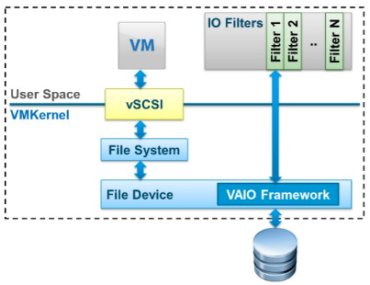
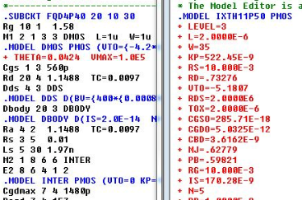
Highlighted Features of 2nd New Mode DAM
Allows multiple users to share a NVMe SSD.
Daemon IOFilter attached to VMs => VAIO program to handle and forward I/Os directly to NVMe.
Not require every single application to link with a 3rd party library (e.g., Intel’s SPDK) and be recompiled.
Transparent to user application (VM-granularity).
Notes:
Here’s some xx of DAM.

Slide 51

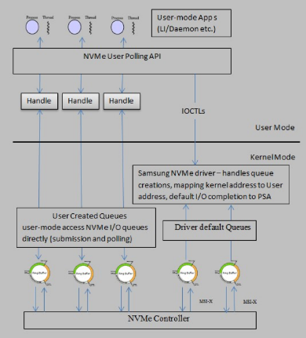
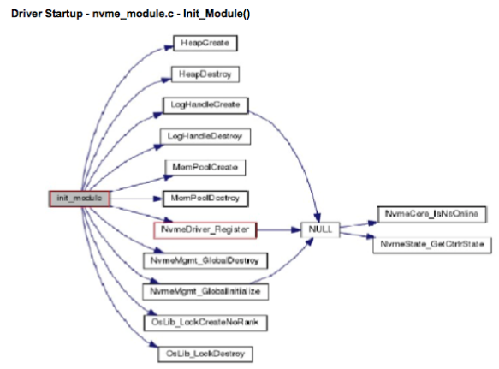
Implementation
  VAIO IOFilter
VM
VM
VM
VM
VM
VM
VMware ESXi Hypervisor
  User Polling Scheme
  NVMe Driver
Notes:
We conduct real implementation based on VMware ESXi hypervisor 6.0.0.
We modified IOFilter,
customized user polling scheme,
rewrote couple modules in the NVMe driver.

Slide 52



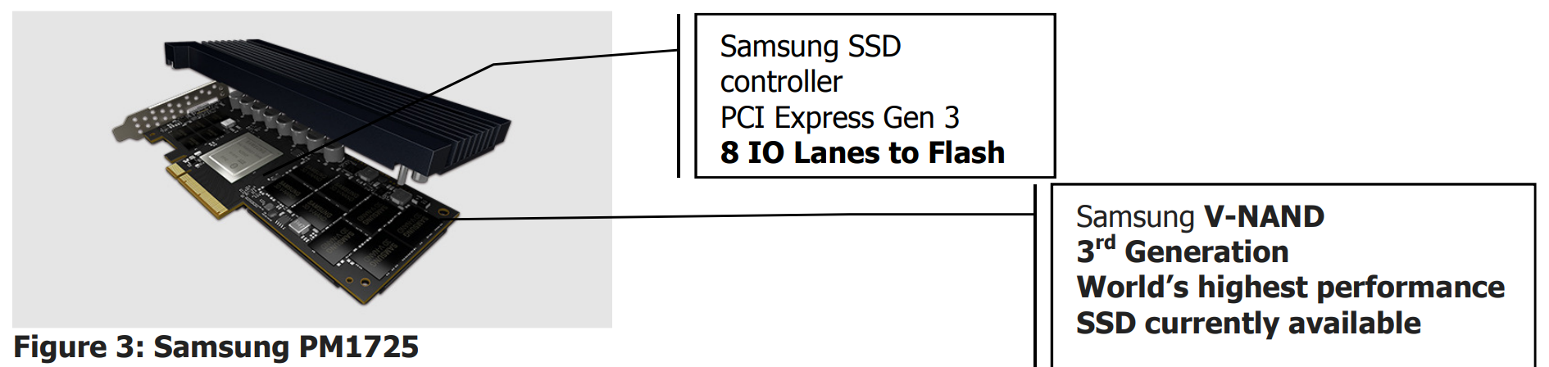
Evaluation Setups
Architecture
Host Server Configuration
VM
VM
VM
VM
VM
VM
VMware ESXi Hypervisor
Notes:
No more than 10% are following DAM.

Slide 53
      Bandwidth and Latency of Read/Write Mixed Workloads
7 different VMs running different workloads
[Obv.1] H-NVMe achieves better performance in majority of cases.
[Obv.2] Small block size workloads, H-NVMe performs much better.
[Obv.3] Size ->256KB, performance improvement -> less.
Because larger I/O => better locality => less room to improve.
Notes:
We run 7 workloads with different average I/O sizes on 7 different VMs hosted by the same hypervisor, config overall seq% of each WLvaries from 30% to 70%.
1. Generally, H-NVMe achieves better performance in all subﬁgures.
2. Small block size workloads, H-NVMe performs much better than the original NVMe framework. Because our algorithm reduce WAF.
3. However, when workload I/O size increases to 256KB (e.g., the “256KB” bars in Fig. (b) and (e)), performance improvement becomes less.
This is because larger average I/O sizes have better locality so that there is less room for performance improvement. Similarly, once I/O size reaches 256KB, the read latency of the original NVMe is even slightly better, see in Fig. (c).

Slide 54
Outline
1. Background and Motivation
2. Review of Preliminary Work
3. I/O Stack Optimization: Hybrid Framework of NVMe SSDs
4. Store vs. Compute: Intermediate Data Caching Optimization
5. Conclusion and Future Work

Slide 55

[6] Store vs. Compute: AdaptCache
Spark stores intermediate RDDs in RAM.
Default caching policy is not optimal.
RAM has limited size.
RDDs have different weights.
How to comprehensively determine which RDD to be cached in the RAM?
AdaptCache Zhengyu Yang, Danlin Jia, Stratis Ioannidis, Ningfang Mi, and Bo Sheng, “Intermediate Data Caching Optimization for Multi-Stage and Parallel Big Data Frameworks”, 2018 IEEE International Conference on Cloud Computing, 2018.
Notes:
This is a joint work with Prof. Stratis. We just present in IEEE Cloud2014.

Slide 56
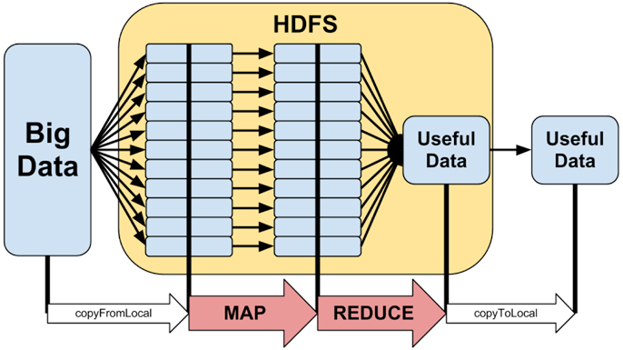
Parallel Computing Platforms
Apache Hadoop
Apache Hadoop
Benefits:
Distribute workloads
Parallelism compute & I/O
Limitations:
Operation is limited
Disk operation intensive
____________________________________________________
* Picture: http://www.hostingadvice.com/how-to/what-is-hadoop
Notes:
Let’s see the history of big data platform.
Since 2011, MapReduce-based big data platform Apache Hadoop is widely used.
Instead of using very expensive centralized supercomputers, we use cluster of affordable enterprise servers.
[click] We distribute workloads by splitting jobs and computing them parallelly.
[click] It also has some limitations, such as the op is limited (map reduce shuffle), and it triggers hard disk IO to save intermediate files.

Slide 57
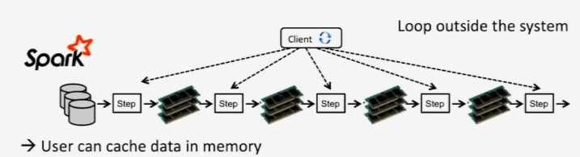

Parallel Computing Platforms
Apache Spark
How to optimize cache?
Spark’s Improvements:
Multiple stages
More operations
Store intermediate data in RAM
Limitations:
RAM is expensive and small
Cache or not rests on app developer
Default evict policy is not optimized
No cross-job overlaps detection
___________________________________________________________________
* Picture: https://acadgild.com/blog/hadoop-vs-spark-best-big-data-frameworks
Notes:
To address these abovementioned limitations, Spark is developed.
[click] It has multi stages and more operations (103) which increase the flexibility of computing.
[click] More importantly, it strives to store all intermediate data into RAM instead of HDD. (RDD=Resilient Distributed Datasets), which significantly improves the perf
[click] However, RAM has limited space and the default Spark cache policy is not optimized.

Slide 58
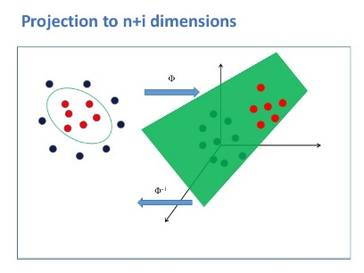
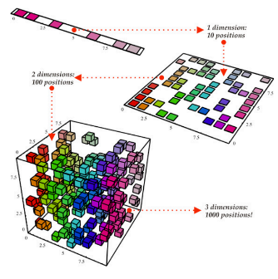
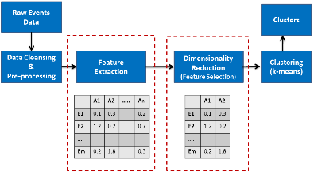
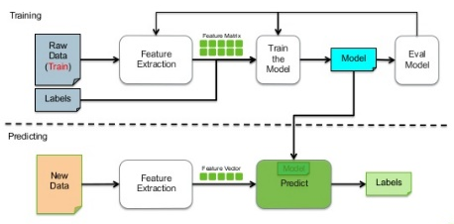
Computational Overlap
Supervised
Learning
Dimensional
Reduction
Projection
Selection
?
RAM
RDD.cache()
Directed Acyclic Graph
CacheOptimizer
_____________________________________________________________________
* Picture: https://en.proft.me/2015/12/24/types-machine-learning-algorithms/
https://www.glassbeam.com/blog/scalable-machine-learning-apache-spark-and-mlbase
http://www.turingfinance.com/artificial-intelligence-and-statistics-principal-component-analysis-and-self-organizing-maps/
Notes:
Before going to details, let’s answer the question:
Why do we need to have cache? The major reason is to reuse some intermediate datasets to avoid computational overlap.
CO is very common in nowadays ML algorithms such as xxx.
For example this DAG shows the map of each spark job. they have lots of reusable RDDs across diff jobs if they have CO.
So our job is to design CO to tell Spark which RDD to be cached in RAM.

Slide 59

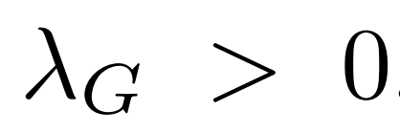
Problem Formulation
G0
G3
G1
G4
G2
G5
(G1)
A Spark job can be represented as a Directed Acyclic Graph G(V, E) .
Multiple jobs can be represented as .
Each job has an arrival rate .
Notes:
Let’s formulate the problem. [Read]
G1 and G5 are identical, hwv, Spark cannot detect cross-job RDD. So the same job will be assigned with new RDD#s.

Slide 60
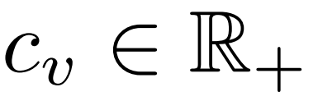
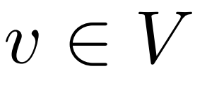
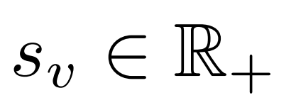
Problem Formulation
G(V, E)
RDD Cost:
5
op(v)
RDD Node:
RDD Size:
Without cache, the expected total work is:
Job Arrival Rate × Job Total Cost
Each RDD’s cost
Notes:
Now let’s go inside a single job.
Spark follows a recursive fashion and iterates from the last RDD.
It checks whether the RDD is cached in RAM, if yes fetch it, else tries to gen it from its parents.
We denote Cv as the RDD comp cost (e.g., the red edge 5), and we can cal the exp ttl wrk without cache as xx x xx.
Where job ttl cost is sum of each RDD’s cost Cv.

Slide 61
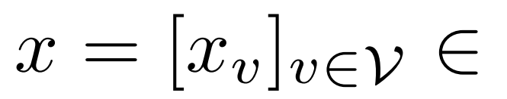
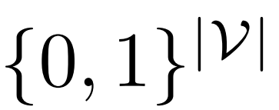
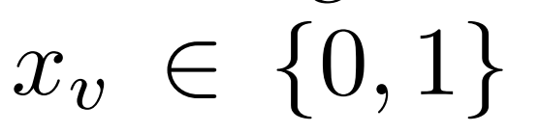

Problem Formulation
G(V, E)
RDD Cost:
5
RDD Node:
RDD Size:
Cache Scheme: , where
With cache, the expected total work is:
Cost of RDD × Cached in RAM?
Notes:
Next, let’s try to compute the ttl exp work WITH a particular cache scheme.
We represent Cache as a vector of Xv, where Xv=1 if V is cached in RAM, else it is 0.
Straightforwardly, the work is rate times the corresponding sum cost summation of cost under cache vector x.

Slide 62
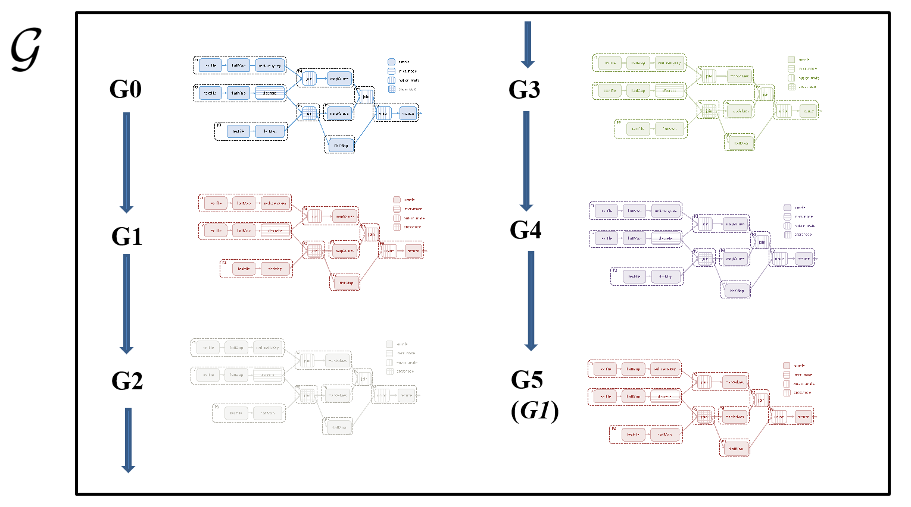
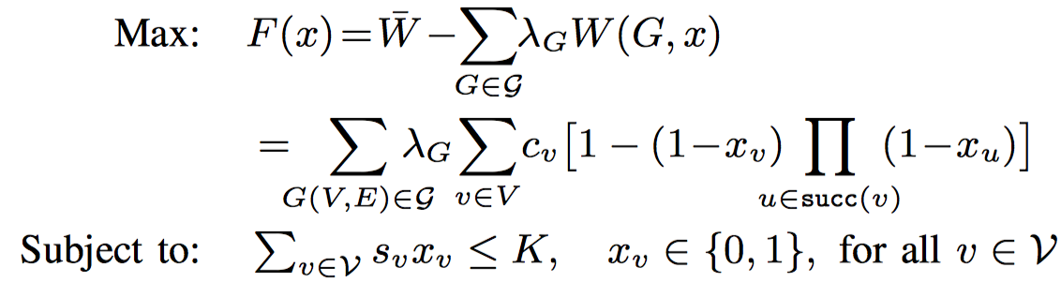
Optimization Framework
RDD.cache()
RAM
Optimizer
Cost c_{v} of computing op(v) needs to be paid
Arrival Rate × Cost under cache x
Expected Total Work without Cache
Actual Total Work with Cache
Cache Gain
NP Hard!
Saved Cost
Cache size constraint
Notes:
Based on these, we introduce an optimization framework for the optimizer.
We want to max the cache gain which is def as the cost a cache scheme can save.
The ex ttl work WITHOUT cache minus the actual work WITH cache, the more it can save the better the cache scheme is.
Cache size constrains that we cannot cache more than RAM size RDDs.
Hwv, NP hard.

Slide 63


Approximation Solution
NP-Hard Optimization Function
A Sandwich Function
Pipage Rounding: there exists a concave function
L : [0, 1] ^{|V|} concave to sandwich F(x)
Concave Relaxation
Notes:
To solve this NP hard problem in a polynomial time, we dev an apprx solution.
F(x) is NP hard, but fortunately we found a sandwich func L(x) to form the upper and lower bounds of F(x).
According to Pipage rounding, we can conduct concave relaxation on L(x).

Slide 64

Algorithm Design
Concave Relaxation
The algorithm should:
Perform projected gradient ascent over concave function L(x).
Maintain at each time a fractional y ∈ [0, 1]^{|V|}, capturing the probability with which each RDD should be placed in the cache.
Collect info from executed jobs to estimate the gradient ∇ L(y).
Estimation distance 1-1/e
Solution is:
Notes:
Based on this concave relaxation, we can conclude that an appx algorithm should:
Perf Grea Dient over L,
Maintain a fractional vector to cap prob of each RDD should be cache or not, collect info to est gradient L(y).
Finally we can find x* as the optimal solution.

Slide 65


Algorithm and Example
AdaptCache
Job Pool
Curr Job RDD Rec. | Historical RDD Rec.
Memory
RDD | Cost
1 | 145.32
2 | 99.67
3 | 543.23
4 | 623.44
5 | 214.42
RDD | Cost
1 | 235.24
2 | 103.43
3 | 964.31
4 | 1032.08
5 | 342.43
6 | 8.41
7 | 73.53
8 | 24.36
9 | 45.36
10 | 65.30
… | …
RDD | Cost
1 | 84.23
2 | 43.23
3 | 343.67
4 | 413.98
5 | 89.43
6 | 22.31
7 | 91.72
8 | 55.43
9 | 72.41
10 | 100.32
… | …
RDD | Cost
1 | 145.32
2 | 99.67
3 | 543.23
4 | 623.44
5 | 214.42
6
7
8
9
10
… | …
RDD | Cost
1 | 84.23
2 | 43.23
3 | 343.67
4 | 413.98
5 | 89.43
6 | 22.31
7 | 91.72
8 | 55.43
9 | 72.41
10 | 100.32
… | …
RDD | Cost
1 | 235.24
2 | 103.43
3 | 964.31
4 | 1032.08
5 | 342.43
6 | 8.41
7 | 73.53
8 | 24.36
9 | 45.36
10 | 65.30
… | …
G0
RDD | Cost
1 | 145.32
2 | 99.67
3 | 543.23
4 | 623.44
5 | 214.42
6
7
8
9
10
… | …
G1
RDD | Cost
6 | 22.31
7 | 91.72
8 | 55.43
9 | 72.41
10 | 100.32
Record
Update
Cache
G0
RDD | Cost
1 | 145.32
2 | 99.67
3 | 543.23
4 | 623.44
5 | 214.42
Moving Average
(Aging Factor)
history and current
…
Notes:
First job G0 comes, after it is done, we have the curr job table.
We also put it into the hist table. We pick top cache size RDDs to be placed in RAM.
The we ran G1, and get G1’s curr job. Then we update it to the hist table with an aging rate to fade out old RDD’s score.
So on and so forth.

Slide 66

Numerical Analysis
J0
R0
R1
R2
J1
R0
R1
R3
DRAM (700MB)
J2
R0
R1
R4
R4
R5
R3
R5
R2
R4
R3
R6
R6
LRU
R2
J3
R0
R1
R5
R1
R1
R1
J4
R0
R1
R6
Adaptive
R2
J0
R0
R1
R2
J1
R0
R1
R3
Time
J2
R0
R1
R4
J3
R0
R1
R5
J4
R0
R1
R6
Notes:
First see a numerical analysis. Assume we have only 700 MB RAM. All RDDs are around 400~500 MB. AKA only one RDD can be placed in RAM.
We compare LRU and our adaptive. We can see that by picking up the most valuable and reusable RDD, we can achieve higher HR and less TTW,

Slide 67



Simulation Experiment
Higher hit ratio
Less accessed data size
Less makespan
Notes:
Next we conduct simulation experiments for [click] 1000 jobs with [3click] different comp overlaps, with expntl arrival rate.
[click] Our results show that comp to LRU FIFO and LCS, we have xx.

Slide 68



Implementation on Spark
Testbesd
Per VM Spec
1GB
DRAM
VM
VM
VM
50GB
Disk
VM
VM
VM
Server Spec
VMware ESXi Hypervisor
Notes:
Lastly, we conduct real imp on Spark.
We use Vmware workstation 12 to host Linux VMs running Spark and HDFS.
Each VM has 1GB DRAM and 50GB disk
This is the spec of our server

Slide 69
Spark Implementation – RDDCacheManager
Header Files
RDDCacheManager
Notes:
We include header files into each benchmark APP.
We built an RDDCacheManager to control cache in each node.
We control the storage mem.

Slide 70

Spark Implementation – Ridge Regression Benchmark
 | Feature1 | Feature2 | Feature3 | Feature4 | Feature5 | …
Row1 | 24.32 | 145.32 | 32.31 | 87.32 | 4.01
Row2 | 543.34 | 99.67 | 92.43 | 64.37 | 32.34
Row3 | 652.43 | 543.23 | 323.13 | 124.34 | 312.12
Row4 | 34.64 | 623.44 | 442.79 | 643.27 | 36.13
Row5 | 313.412 | 214.42 | 4543.67 | 44.21 | 75.43
…
Target
Source
t₁
Job₁: Cal (f₁ = R (f₃, f₄)), Cal (f₇ = R (f_{12,} f₁₆, f₄), …
t₂
Job₂: Cal (f₂ = R (f₃, f₄)), Cal (f₁ = R (f₃, f₄)), …
t₃
Job₃: Cal (f₅ = R(f₃, f₄)), Cal (f₁ = R (f₃, f₄)), …
t₄
Job₄: Cal (f₁ = R (f₃, f₄)), Cal (f₆ = R (f₁ , f₅ , f₂₁)), …
…
Notes:
We use Ridge regression ben.
For example. We have a huge DB.
Randomly select a feature as target and multiple feature columns as source. Regress target from source.

Slide 71
Hit Ratio & Makespan Results
12%
13%
Higher hit ratio
Less
makespan

Slide 72
Outline
1. Background and Motivation
2. Review of Preliminary Work
3. I/O Stack Optimization: Hybrid Framework of NVMe SSDs
4. Store vs. Compute: Intermediate Data Caching Optimization
5. Conclusion and Future Work

Slide 73
Conclusion and Future Work
Conclusion
Investigate SSD-HDD hybrid and all-flash storage systems, I/O patterns and I/O stack bottlenecks, cost model of write amplification, and cache/tier algorithms.
Derive new efficient resource allocation schemes for data processing platforms to improve performance and reliability, with the consideration of replication, endurance and owning cost.
Implement and evaluate all the proposed algorithms in real big data and cloud computing platforms.
Integrate our minTCO dispatch algorithm to our AutoTiering manager for all-flash datacenter storage systems as an unified solution to improve performance, balance endurance, and reduce TCO.
Investigate new storage devices (such as 3D XPoint memory), and further accelerate I/O speed.
Study new “never-delete-file” I/O patterns and new techniques to support the related I/O requirements, such as decentralized blockchain storage.
Future Work

Slide 74



Ph.D. Publications (Papers)
Improving Virtual Machine Migration via Deduplication, 11th IEEE International Conference on Mobile Ad Hoc and Sensor Systems, 2014.
Improving Flash Resource Utilization at Minimal Management Cost in Virtualized Flash-based Storage Systems, IEEE Transactions on Cloud Computing, vol. 5, no. 3, pp. 537-549, July-Sept. 1 2017.
A Fresh Perspective on Total Cost of Ownership Models for Flash Storage in Datacenters, 8th IEEE International Conference on Cloud Computing Technology and Science. 2016.
GREM: Dynamic SSD Resource Allocation in Virtualized Storage Systems with Heterogeneous IO Workloads, 35th IEEE International Performance Computing and Communications Conference, 2016.
eSplash: Efficient Speculation in Large Scale Heterogeneous Computing Systems, 35th IEEE International Performance Computing and Communications Conference, 2016.
Understanding Performance of I/O Intensive Containerized Applications for NVMe SSDs, 35th IEEE International Performance Computing and Communications Conference, 2016.
AutoReplica: Automatic Data Replica Manager in Distributed Caching and Data Processing Systems, 1st IEEE International Workshop on Communication, Computing, and Networking in Cyber Physical Systems, 2016.
SEINA: A Stealthy and Effective Internal Attack in Hadoop Systems, International Conference on Computing, Networking and Communications, 2017.
AutoPath: Harnessing Parallel Execution Paths for Efficient Resource Allocation in Multi-Stage Big Data Frameworks, 26th International Conference on Computer Communications and Networks, 2017.
EA2S2: An Efficient Application-Aware Storage System for Big Data Processing in Heterogeneous Clusters, 26th International Conference on Computer Communications and Networks, 2017.
FiM: Performance Prediction Model for Parallel Computation in Iterative Data Processing Applications, 10th IEEE International Conference on Cloud Computing, 2017.
Accelerating Big Data Applications Using Lightweight Virtualization Framework on Enterprise Cloud, 21st IEEE High Performance Extreme Computing Conference, 2017.
AutoTiering: Automatic Data Placement Manager in Multi-Tier All-Flash Datacenter, 36th IEEE International Performance Computing and Communications Conference, 2017.
H-NVMe: A Hybrid Framework of NVMe-based Storage System in Cloud Computing Environment, 36th IEEE International Performance Computing and Communications Conference, 2017. Best Paper Award
Cyber-Physical System Enabled Nearby Traffic Flow Modelling for Autonomous Vehicles, 36th IEEE International Performance Computing and Communications Conference, Special Session on Cyber Physical Systems: Security, Computing, and Performance, 2017.
Enhancing SSDs with Multi-Stream: What? Why? How?, 36th IEEE International Performance Computing and Communications Conference, Poster, 2017.
Automatic and Scalable Data Replication Manager in Distributed Computation and Storage Infrastructure of Cyber-Physical Systems, Scalable Computing: Practice and Experience, Special Issue on Communication, Computing, and Networking in Cyber-Physical Systems, Vol. 18, No. 4, pp. 291–311.
Docker Container Scheduler for I/O Intensive Applications running on NVMe SSDs, IEEE Transactions on Multi-Scale Computing Systems, DOI: 10.1109/TMSCS.2018.2801281.
EAD: Elasticity Aware Deduplication Manager for Datacenters with Multi-tier Storage Systems, Cluster Computing, DOI: 10.1007/s10586-018-2141-z, 2018.
AutoAdmin: Admission Control in YARN Clusters Based on Dynamic Resource Reservation, Scalable Computing: Practice and Experience, Special Issue on Advances in Emerging Wireless Communications and Networking, Volume 19, Issue 1, Pages 53-67, 2018.
Intermediate Data Caching Optimization for Multi-Stage and Parallel Big Data Frameworks, 2018 IEEE International Conference on Cloud Computing, 2018.
FIOS: Feature Based I/O Stream Identification for Improving Endurance of Multi-Stream SSDs, IEEE International Conference on Cloud Computing, 2018. Best Paper Award
Sponsored by

Slide 75
Ph.D. Publications (US Patents)
Online Flash Resource Allocation Manager Based on TCO Model", US15/092156, US20170046089A1, 2016.
Online Flash Resource Migration, Allocation, Retire and Replacement Manager Based on a Cost of Ownership Model", US15/094971, US20170046098A1, 2016.
Memory Device Having a Translation Layer with Multiple Associative Sectors", US15/093682, US2017/0242583A1, 2016.
I/O Workload Scheduling Manager for RAID/non-RAID Flash Based Storage Systems for TCO and WAF Optimizations", US15/396186, 2017.
Adaptive Caching Replacement Manager with Dynamic Updating Granularities and Partitions for Shared Flash-Based Storage System", US15/400835, US20180067961A1, 2017.
Duplicate In-memory Shared-intermediate Data Detection and Reuse Module in Spark Framework", US15/404100, US20180067861A1, 2017.
In-memory Shared Data Reuse Replacement and Caching", US15/404121, US20180067869A1, 2017.
Automatic Data Replica Manager in Distributed Caching and Data Processing Systems", US15/408328, US20180069944A1, 2017.
Efficient Data Caching Management in Scalable Multi-stage Data Processing Systems", US15/423384, US20180067857A1, 2017.
DCPM: Dynamic Cache Partition Manager in Heterogeneous Virtualization Cloud Cache Environment", Patent Pending, 2017.
Automatic Data Placement Manager in Multi-Tier All-Flash Datacenter", US62/534647, 2017.
A Hybrid Framework Design of NVMe-based Storage System in Cloud Computing Storage System", US62/540555, 2017.
ACLB: Adaptive Cache Load Balancer for SSD-based Cloud Computing Storage System", Patent Pending, 2017.
Datacenter Storage Evaluation Framework based on Simulation", Patent Pending, 2017.
All of them are done during my three summer interns in

Slide 76
Acknowledgment
Many thanks to my:
PhD Advisor,
Committee Members,
Labmates in NUCSRL Lab,
Colleges in Samsung Semiconductor Lab,
Family Members.

Slide 77



















NUCSRL Lab

Slide 78
Thank you for listening!
Zhengyu Yang
July 31, 2018

