Slide 1
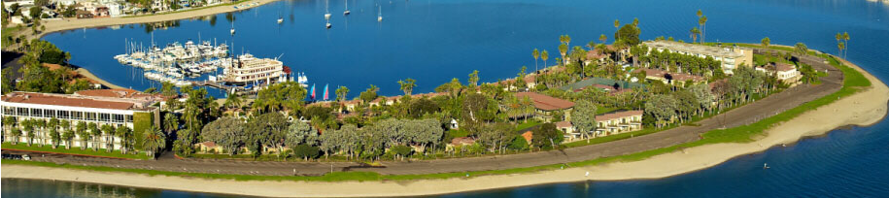

AutoTiering: Automatic Data Placement Manager in
Multi-Tier All-Flash Datacenter
36th IEEE International Performance Computing
and Communications Conference
IPCCC 2017, San Diego, California, USA.
Zhengyu Yang ^{[1]}, Morteza Hoseinzadeh ^{[2]}, Allen Andrews ^{[3]},
Clay Mayers ^{[3]}, David Thomas Evans ^{[3]}, Rory Thomas Bolt ^{[3]},
Janki Bhimani ^{[1]}, Ningfang Mi ^{[1]}, Steven Swanson ^{[2]}
^{[1]} Dept. of Electrical & Computer Engineering, Northeastern University, MA
^{[2]} Dept. of Computer Science & Engineering, University of California San Diego, CA
^{[3]} Samsung Semiconductor Inc., Memory Solutions Research Lab, San Diego, CA
Notes:
Hi everyone, my name is Zhengyu Yang. I’m a Ph.D. candidate from NEU. Today I’m going to talk about our recent work AT.
This was done during my summer internship at SS, and it is a joint work with UCSD.

Slide 2

Outline
1. Background and Motivation
2. Problem Formulation
3. Approximation Algorithm Design
4. Implementation
4. Performance Evaluation
6. Conclusion

Slide 3
Outline
1. Background and Motivation
2. Problem Formulation
3. Approximation Algorithm Design
4. Implementation
4. Performance Evaluation
6. Conclusion

Slide 4
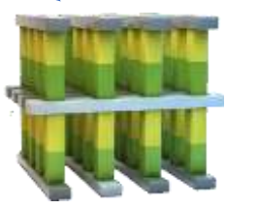
Datacenter Storage System Evolution
Write Latency and Cost Per GB Comparison
4.68$/GB
Gen. 3
All-Flash Datacenter
4.50$/GB
DRAM
nanosec
0.57$/GB
Gen. 2
SSD-HDD
Hybrid Datacenter
0.30$/GB
3D XPoint
10μs
Gen. 1
All-HDD
Datacenter
0.28$/GB
NVMe SSD
20μs
0.25$/GB
MLC SSD
750μs
TLC SSD
1125μs
HDD
10ms
Notes:
We see the storage dev evolution roadmap.
Both price & IO perf keeps increasing from traditional HDD, multiple end of SSDs, to 3D Xpoint and DRAM.
For datacenter point of view, 1st gen datacenter is all-HDD, later, SSD is used as cache for SSD-HDD hybrid datacenter.
With the SSD price decreasing and SSD capacity increasing, All-Flash datacenter comes earlier than pp’s expectation.
In this pp, we focus on how to optimize the perf of all-flash datacenter.

Slide 5

Why not traditional caching/tiering algorithms?
1. Traditional caching algorithm is not suitable:
=> Flash devices do not have huge speed gap
≠
2. Traditional caching algorithm has two copies:
=> too expensive for SSDs to have duplications
Cache
Backend
3. Traditional tiering algorithm does not consider specialties of SSDs:
Rd./Wrt. Performance
Spatial Capacity
Write Amplification
Notes:
Why don’t’ we use trad. caching/tier algorithm?
Unlike HDD and SSD, SSDs do not have huge speed gap, so trad. Cache not suitable
Trad. Cache needs two copies either wrt back or wrt thru, while SSD is expensive so we can’t afford this
On the other hand, tier does not consider specialties of SSDs, eg. Some of SSD are performance tier others are capacity tier

Slide 6
Design Goals
Develop an automatic data placement and tiering manager to:
VMware ESXi
1. Handle virtual machine disk files (VMDK) allocation and migration.
2. Best utilize the storage resource, optimize the performance, and reduce the migration overhead.
3. Match VM workload demands and SSD specialties.
Notes:
Thus, in this work, our goal is to dev auto data placement tier manager,
1. Handle VMDK allocation and migration, notice that we only focus on VMDK storage files, not RAM.
2. Best utilize the storage resource, optimize the performance, and reduce the migration overhead.
3. Match VM workload demands and SSD specialties.

Slide 7
Outline
1. Background and Motivation
2. Problem Formulation
3. Approximation Algorithm Design
4. Implementation
4. Performance Evaluation
6. Conclusion

Slide 8
Three Major Components
VAIO IOFilter per VMDK
Daemon application per VM Hypervisor (server)
Controller per Cluster
Notes:
vSphere APIs for I/O Filtering (VAIO)

Slide 9

Rethink VMDK Migration
[1 VMDK]
 |  |  |  |  | Tier 1
 |  |  |  |  | Tier 2
 |  |  |  |  | Tier 3
800 IOPS
VMDK1
500 IOPS
VMDK1
300 IOPS
VMDK1
Q: Why trigger migration for VMDK1?
A: For better performance after migration.
Notes:
Let’s rethink the purpose of VMDK migration. Assume xxx. Originally on t3 with thrup 300IOPS, if mig to t2 xxx.
So we can answer the question why, because for better performance after mig.

Slide 10
Rethink VMDK Migration
[n VMDKs]
 |  |  |  |  | Tier 1
 |  |  |  |  | Tier 2
 |  |  |  |  | Tier 3
VMDK1
VMDK2
VMDK3
VMDK4
VMDK5
VMDK6
VMDK7
VMDK8
VMDK9
VMDK10
VMDK11
VMDK12
VMDK13
VMDK14
VMDK15
For better performance after migration => All VMs to 1st tier
Not Good!
Capacity Limitation => Optimization under constraints
Consider all VMs and SLA => Weighted global performance gain
Migration is expensive => Consider migration penalty
Notes:
But, what if we have multiple VMDKs?
If we still mig each VM for better performance, then all VM shall be mig to 1st tier not good because we are running out of space apparently.
Thus, in this case, an optimal solution needs to consider capacity limitation,
Also, diff VMs may have diff weight, SLA, so we need to find the weighted global perf gain.
Lastly, we need to consider migration penalty since migration cost is expensive.

Slide 11
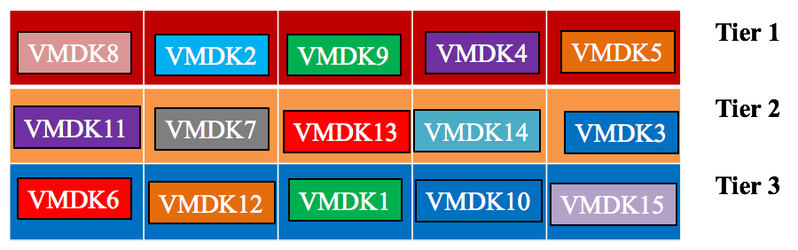
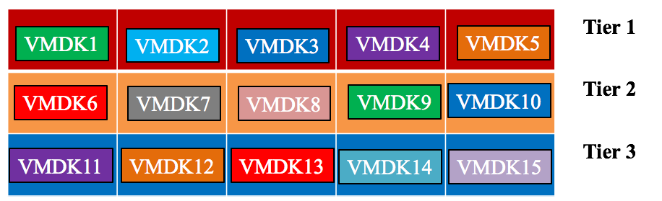
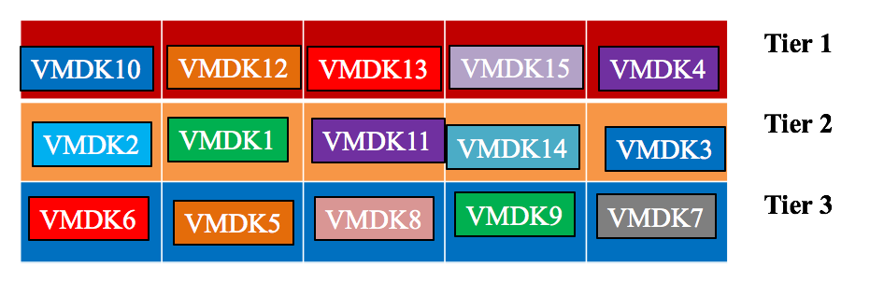
Rethink VMDK Migration
[n VMDKs across time]
VM I/O access pattern change during runtime ^{[1]}
τ_{k-1}
Each VM,
Each Tier,
Across Time!
τ_{k}
τ_{k+1}
[1] Improving Flash Resource Utilization at Minimal Management Cost in Virtualized Flash-based Storage Systems
Notes:
But that's not the end, VM I/O patterns change during time, so the optimal solution should migrate VMDKs across time to optimize each time window.

Slide 12
Optimization Framework
For all VMs, tiers, and time windows
Performance Gain
Performance Penalty
Profit =
Hard to solve during runtime
VMs should be deployed
VM’s spatial size keeps
same after migration
Predictable performance
after migration
Upper bound for each
type of resource
Notes:
Based on these analysis, we build an optimization framework to formulate the problem.
Our goal is to max profit which is cal as perf gain – perf pen, for all tier, all vm and all time epochs
Subject to some constraints such as xx.
The problem is hard to solve in poly during runtime. Especially for all epochs optimization is hard.

Slide 13
Outline
1. Background and Motivation
2. Problem Formulation
3. Approximation Algorithm Design
4. Implementation
4. Performance Evaluation
6. Conclusion

Slide 14
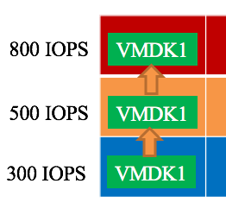
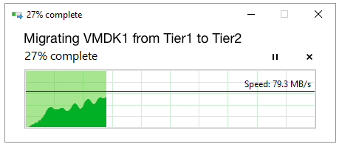
Algorithm Overview
Relax: from “global optimizing across time” to “only optimizing for each epoch”
Optimize: Profit = Performance Gain - Performance Penalty
?
Problem 1: Performance Gain How to estimate performance without actual migration?
Problem 2: Optimization How to match tier specialties and VM demand?
Problem 3: Performance Penalty How to estimate migration costs?
Notes:
To obtain the result close to the optimal solution in a polynomial time, we have to relax xxx (runtime greedy)
We have three subproblems: xxx

Slide 15
[Problem 1] Performance Gain and Injected Latency
VAIO IOFilter API to inject latency to slow down disks
Disk Speed Sensitive
Workload
Performance
Disk Speed Insensitive
SSD Speed
[Obsv.] Sensitivities to disk performance improvement are different.
[Hint1] Most-sensitive VMDK should be migrated to best performance tier.
[Hint2] Estimate the performance gain without actual migration.
Notes:
For the first subproblem, let’s see an interesting observation.
We use vSphere API IOFilter to manually inject latencies to slow down disks.
We see the correlation between SSD spd and WL perf.
Obsv is xxx.
2 Hints.

Slide 16
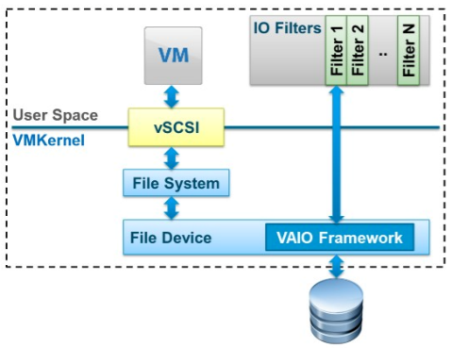
Tier Speed Sensitivity Calibration
?
?
T1
█ V1
⬤V2
▲V3
T2
█ V1
⬤V2
?
▲V3
T1
T3
█ V1
⬤V2
▲V3
Gap between tiers
(2000μs)
T2
  VAIO IOFilter
T3
Mimic other tiers
Injected latency
(Slow down ↓ )
Mimic other tiers
Regressed values
(Speed up ↑)
Notes:
Based on this, we designed calib method to estimate perf change after mig.
3 VMs running on 3 tiers, and we know the spd gas btw tiers is 2000microsec.
Right hand side is a injected latency correlation figure.
We align the X-axis based on absolute latency.
Square, round, triangle dots are actual workload avg I/O lat.
We can use APIs in IOFilter to slow down disks to mimic VM’s perf on other tiers.
But, how upgrading to a higher tier? Apparently we can’t speed up a disk, so we have to regress from the curve.
So we can get these results.
[confidence, multiple times…]

Slide 17
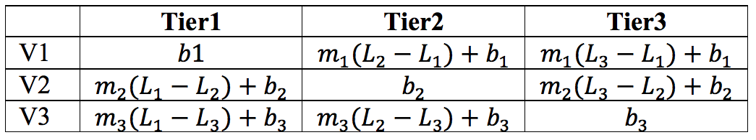
Tier Speed Sensitivity Calibration
Avg I/O latency
?
?
T1
█ V1
⬤V2
▲V3
T2
█ V1
⬤V2
?
Actual
▲V3
Estimated
T3
█ V1
⬤V2
▲V3
Other Performance Metrics
T3
T2
T3
T1
T2
T1
Capacity Matrices
16
Notes:
Now we have a matrix of avg io lat. Blue cells are actual data, red are regressed.
We next convert them to throughput and BW, and normalized by the disk capacity.
We call this capacity matx. For each tier we have a matrix like this, we can have more categories of resources, such as storage space, etc.
Now we have the perf estimation results.

Slide 18
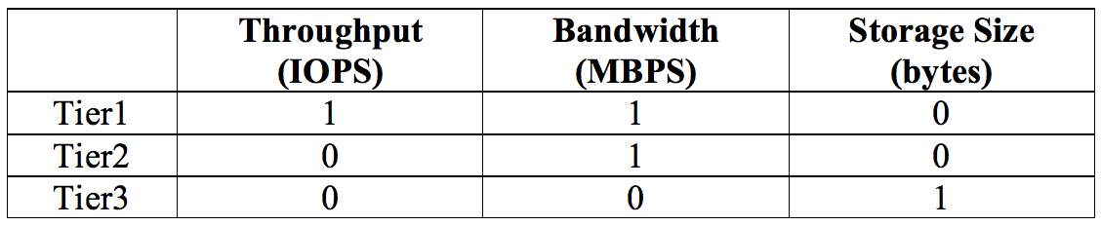
[Problem 2] How to match VMs and tier specialities?
Tier 1: Good at TP and BW
Tier 2: Good at BW
Tier 3: Good at Space
Build a matrix
Tier Specialty Matrix
Notes:
Now we have the perf estimation. But how to “match” them with each disk tier’s specialty?
We build a so called tier specialty matrix. E.g. xxx. In fact, in real implementation, they do not necessarily to be integers.

Slide 19
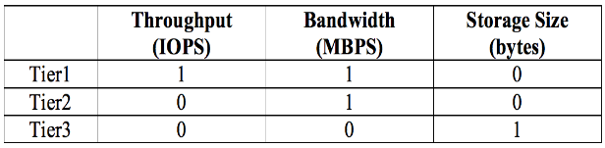
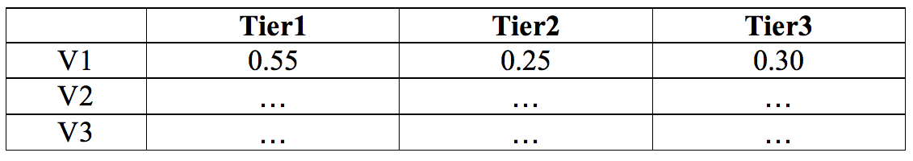
[Problem 2] How to match VMs and tier specialties?
T3
T1
T2
T3
×
T2
T1
Tier Specialty Matrix
Capacity Matrices
=
Current Performance Score Matrices
Orthogonal Match
Final Score
History Score
Current Perf Gain
Current Perf Penalty
Comprehensive Scoring
vmSize
vmSize
migCost = =
migSpeed
min(remReadRate, remWriteRate)
SSD_out
SSD_in
remReadRate
remWriteRate
Migration Cost
18
18
Notes:
Next, we multiplicate tier specialty matx with capacity matrix to get the curr perf score matrices.
This is called orthogonal matching, like used in CDMA tech.
The core idea is to let VMs who gets higher perf on a tier’s specialty to have higher score on that tier.
This is the way we cal the final score. it considers history and also perf penalty, we call it comprehensive scoring. since mig is exp, so we need to reduce mig#.
Speclly, migCost is estimated by dividing vmSize by migSpeed which is bottlenecked by the min value of rem read and rem write rate on SSD out and in resp.
Once we have the score, AT will periodically fulfill tiers by the order of ranking.

Slide 20
Outline
1. Background and Motivation
2. Problem Formulation
3. Approximation Algorithm Design
4. Implementation
5. Performance Evaluation
6. Conclusion

Slide 21

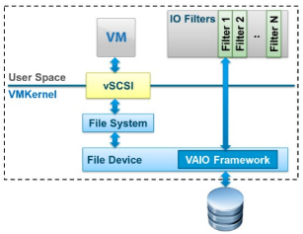


Implementation Details
Implementation
Performance Tier
Samsung PM953 (NVMe)
VM
VM
VM
VM
VM
VM
IOFilter
IOFilter
IOFilter
VMware ESXi Hypervisor
AutoTiering Daemon
AutoTiering Controller
Middle Tier
Samsung PM1633 (SAS)
Capacity Tier
Samsung PM863 (SATA)
Notes:
We conduct real implementation of AT on Vmware ESXi 600.
VMs are running Linux, and we use FIO and IOM to gen WL to eval.
IOFilter, Daemon and ctlr are three major components.
We use xx to record IO patterns.
We use three ssds xxx.

Slide 22
Outline
1. Background and Motivation
2. Problem Formulation
3. Approximation Algorithm Design
4. Implementation
5. Performance Evaluation
6. Conclusion

Slide 23
Evaluation Setups
        Workloads
Performance Metrics
  1. Throughput (IOPS)
  2. Bandwidth (MBPS)
  3. I/O Latency (Sec)
Tested Algorithms
    1. IDT (IOPS-only Dynamic Tiering)
    2. EDT (IOPS+Capacity Dynamic Tiering)
Notes:
Tested Algorithms
1. IDT (IOPS Dynamic Tiering), implements dynamic conﬁguration and placement using a greedy IOPS-only criteria where higher IOPS extents move to higher IOPS tiers.
2. EDT (Extent-based Dynamic Tiering), updates VM-tier assignment for every epoch, based on both VM capacity and IOPS requirements.
To fully utilize the high speed all-ﬂash datacenter, we slightly modiﬁed IDT and EDT to support per-VMDK-based operation.

Slide 24
Performance Results of All Tiers
Higher Throughput
Higher Bandwidth
Lower Latency
Notes:
AutoTiering achieves up to 45% and 39% higher IOPS than IDT and EDT.
Similar results can be obtained for bandwidth and latency as shown in Figs. 3(b) and (c).
B IDT better? IOPS-only, so migrate high IOPS to first 2 disks, but, spatial util not good, so latency bad

Slide 25
CDF Results of All Tiers & Normalized Migration Costs
CDF Results of All Tiers
AT: Majority > 100K
AT: Half > 125K
IDT EDT < 75K
AT: Majority > 1200
IDE EDT < 1000
Normalized Migration Costs
Less Migrations
Notes:
Distribution of total TP and BW of all tiers for different algorithms.
Fig(a): AT (red), majority of I/Os has more than 100K IOPS, even half of them have more than 125K IOPS.
In contrast, 90% of I/Os are less than 100K IOPS (blue curve) under IDT, and almost all I/Os from IDT are less than 100K (green curve).
Fig(b), majority (around 90%) of IDT and EDT I/Os are less than 1,200 MBPS, while more than half of AutoTiering’s I/Os can achieve larger than 1,200 MBPS bandwidth.

Slide 26
Runtime Changes of Throughput, Bandwidth, and Latency
Higher Throughput
TP
BW
LT
Higher Bandwidth
Lower Latency
1. IDT 2. EDT 3. AT
Notes:
TP & BW: AT achieves better throughput and bandwidth performance than IDT and EDT.
LT: TA is“thicker” than that in IDT and EDT (after AutoTiering’s warming up periods from 0-3 epochs).
Better utilize TP and BW resources of each tier by proper and less migrations.
In (i), we see that the majority of the latency of AutoTiering is located in tier 3 (the write latency “T3 Rd Lat”), which is because that tier 3 is regarded as the capacity tier to replace HDD.
As a result, AutoTiering migrates read-intensive VMs with large VMDKs to leverage tier 3, and leaves tiers 1 and 2 for other write-intensive workloads.

Slide 27
Outline
1. Background and Motivation
2. Problem Formulation
3. Approximation Algorithm Design
4. Implementation
5. Performance Evaluation
6. Conclusion

Slide 28
Conclusion
Motivations:
  All-flash datacenter is coming.
  Existing tiering/caching algorithms are not suitable.
Proposed:
  Optimize the virtual machine performance.
  Allocating and migrating VMs across multiple SSD tiers.
Techniques:
  Injected latency: estimate performance of VM on each tier.
  Optimization framework: historical / predicted factors, migration cost.
Implementation:
  VMware ESXi 6.0.0, VAIO IOFilter.
Findings:
  AutoTiering can signiﬁcantly improve system performance.
Future Work:
  Support KVM and Xen.
  Replace “injected latency” with lightweight approaches.

Slide 29
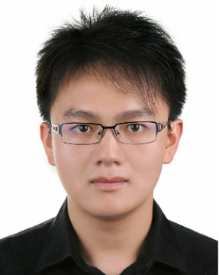





Q & A
Thanks
Z. Yang M. Hoseinzadeh A. Andrews C. Mayers
D. Evans R. Bolt J. Bhimani N. Mi S. Swanson
Notes:
Improve both performance and overhead:
maximize the I/O hit ratio.
minimize the I/O costs.
Splits the entire SSD space into two zones:
Long-term: performance isolation, reserve space for each VM.
Short-term: fair compete, absorb bursties
Methodology:
Leveraging the feedback of workload changes and allocation performance, GREM can dynamically adjust the partitions:
Inside long-term zone (per VM)
Between long-term and short-term zones
Evaluation shows that GREM can:
Utilize beneﬁts of SSDs and improve overall IO hit ratio and cost.
Detect and quickly adapt to workload changes by shifting SSD resources between and inside two zones.

