Slide 1

GREM: Dynamic SSD Resource Allocation in
Virtualized Storage Systems with Heterogeneous VMs
35th IEEE International Performance Computing
and Communications Conference
IPCCC 2016, Las Vegas, Nevada, USA
Zhengyu Yang ^{[1]}, Jianzhe Tai ^{[1]}, Janki Bhimani ^{[1]},
Jiayin Wang ^{[2]}, Ningfang Mi ^{[1]}, and Bo Sheng ^{[2]}
^{[1]} Dept. of Electrical & Computer Engineering, Northeastern University, MA
^{[2]} Dept. of Computer Science, University of Massachusetts Boston, MA
IEEE IPCCC, Dec 2016
Notes:
Hi everyone, my name is Zhengyu Yang. I’m fifth year Ph.D. candidate from NEU.
The co-authors Jianzhe and Janki are from NEU. Ningfang is my Ph.D. advisor.
This is a joint work with a team from Umass Boston. Jiayin ang Prof Bo are from Umass Boston.

Slide 2

Contents
Background and Motivation
Design of GREM
Evaluation and Validation
Conclusion

Slide 3
Contents
Background and Motivation
Design of GREM
Evaluation and Validation
Conclusion

Slide 4



Motivation
VM
VM
VM
VM
VM
VM
Benefits of Flash Memory
High Throughput
Low IO Latency
Deployment of SSD
As a Secondary-Cache
As a Storage Tier
Issues
Diversity: Different VMs
Dynamic: IO changes overtime
Our Focus
How to assign the SSD for each VM?
VM
VM
VM
VM
VM
VM
Hypervisor
Hypervisor
RAM
RAM
SSD
SSD
HDD
HDD
Storage Pool
Storage Pool
Secondary Cache
Storage Tier
Notes:
Due to SSD’s high throughput and low IO latency, Flash memories are currently widely used in datacenter storage systems.
As shown in the right figure, there are two ways to deploy SSD in datacenters: Flash as cache and Tier storage.
But whatever the deployment solution is, there are still two issues:
Different VMs are running upon the hypervisor and sharing the Flash disk. They have different IO patterns, then how to assign the space for each VM to best utilize the SSD?
Even for one single VM, its IO behavior may vary overtime, fixed SSD space size may not be the best solution. For example, backup and video streaming. Do we really need to cache this huge amount of data that will not be so useful in the future?
Motivated by these, in this paper, we mainly focus on the problem of how to assign the SSD for each VM to improve the IO performance and reduce the IO costs.

Slide 5


Two Straightforward Approaches
Performance Isolation
Each VM has a fixed size of Flash
Fair Competition
All VMs fairly compete Flash
Hit Ratio
Hit Ratio
CacheUnfriendly
SSD Size
CacheFriendly
Notes:
Two straightforward approaches can be used to allocate SSD resources among multiple VMs.
First one is called performance isolation, which assigned fixed size of Flash to each VM so that each VM has guaranteed cache resource.
Second one is called fair competition, where all workloads simply compete the Flash resource based on their IO popularities.
Are they good enough to go?
Left Figure shows the IO hit ratio results under different SSD sizes
FC’s overall hr is higher. Because PI cannot fully utilized the SSD (some idle).
To solve this issue, FC further allow VMs to compete for the resource so that its HR is higher.
But if we zoom in and take a look at each workload, we will see that in fact, under FC, some workloads’ hit ratio dramatically increased, with the cost of other workloads having worse performance.
So CU is affecting others!
The reason is these cu workloads have bursties and under FC, it flushed all other critial datasets.
These bursties are having large working set size and not so reusable, no need to cache.
Sum, two app cannot work well, take adv of benefits of these two app.

Slide 6
Contents
Background and Motivation
Design of GREM
Evaluation and Validation
Conclusion
Notes:
We characterize the write ampliﬁcation (WA) of SSDs as a function of fraction of sequential writes in a workload.
We plug this WAF function into our proposed Total Cost of Ownership (TCO) model, which also considers capital and operational cost, estimated lifetime of Flash under different workloads, resource restrictions and performance QoS.
Based on the TCO model, we build the online workload allocation algorithm minTCO and minTCO-Perf algorithms.
Experimental results show that minTCO reduces the ownership cost, and minTCO-Perf further balances the load among disks and maximize the overall resource utilization, while keeping the TCO as low as possible.

Slide 7

Global Resource Manager: GREM
Long-Term Zone
Short-Term Zone
  Key Idea:
  Combine benefits of two approaches
  Divide SSD into two zones:
    Long-Term Zone:
      Reserve SSD for each VM
      Guaranteed min space
      Protected and not affected by others
      Good for cache friendly VMs
    Short-Term Zone:
      Fairly compete among VMs for workload changes
      Absorb bursties
      Good for cache unfriendly VMs
Notes:
Based on these motivation, we proposed a new global Flash resource manager GREM.
The key idea is combine the benefits from the abovementioned two approaches. We divide the SSD into 2 zones.
LT: one VM will not affect others. Guaranteed min cache size. Protect CF
ST: like CF, absorb bursties, good for CU
We next need to think about how to assign the size of these partitions.
In detail, there are two steps.
Step1: how to assign the size of LT and ST zones: 50:50 25:75? GREM can dyn div them by using the feedbacks from both cache perf and wk bursty
Step2: how to determine each VM’s size in LT? GREM will reservice based on their IO changes.
Lastly, to
Setp2:

Slide 8
Global Resource Manager: GREM
Long-Term Zone
Short-Term Zone
  Two-Step Dynamical Partition Schemes:
  [Step1] Flexibly divide sizes of two zones by leveraging the feedbacks from cache performance and workload changes.
  [Step2] Dynamically adjust the reservation for each VM in long-term zone based on IO pattern history.
Notes:
Based on these motivation, we proposed a new global Flash resource manager GREM.
The key idea is combine the benefits from the abovementioned two approaches. We divide the SSD into 2 zones.
LT: one VM will not affect others. Guaranteed min cache size. Protect CF
ST: like CF, absorb bursties, good for CU
We next need to think about how to assign the size of these partitions.
In detail, there are two steps.
Step1: how to assign the size of LT and ST zones: 50:50 25:75? GREM can dyn div them by using the feedbacks from both cache perf and wk bursty
Step2: how to determine each VM’s size in LT? GREM will reservice based on their IO changes.
Lastly, to
Setp2:

Slide 9
[Step 1] Dynamic Partition Between Long-term/Short-term Zone
Long-Term Zone
Short-Term Zone
  Non-bursty: Conservative
    Purely use cache performance feedback
    Based on each zone’s contribution
  Bursty: Aggressive
    Further consider workload change to absorb bursty traffic
    Need more space for short-term “reusable” datasets in spikes to increase hit ratio
Notes:
First step is to dyn partition btw LT and ST zones.
According to our observation, different strategies should be used for different case.
In detail, the strategy switcher will use conservative allocation for NB case. This is purely based on the cache perf feedback.
For bursty case, aggressive allocation will be used, which further consider workload change to absort spikes. Need more space for short-term reusable bins to cache in SSD.
In the next two slides I will show a demo.

Slide 10
[Non-Busty Case] Conservative Adjustment
Non-Bursty
Current Epoch Partition
Long-term Zone | Short-term Zone
Current Epoch Accessed IO Addresses
Hit in Long-term Zone | Hit in Short-term Zone | Not Hit
Predict based on Hit Contribution Ratio
Next Epoch Partition
Long-term Zone | Short-term Zone

Slide 11
[Bursty Case] Aggressive Allocation
Current Partition
Bursty
Long-term Zone | Short-term Zone
Sliding Window (Recent 10 Epochs Accessed IO Addresses)
Found in Long-term Zone | Others
Avg hit time value of bins found in Lz as threshold
Qualified Short-term hot bins | Others
Partition
Next Epoch
Long-term Zone | Short-term Zone
Notes:
Why sliding window? Filter out short-term hot bins.
Reason is that when spike comes we only want to absorb reusable bins in the spike and pass these one-time use part of the spike into the HDD
Spike comes -> STZ increase
How to increase?
We use STZ to filter out reusable short-term hot bins

Slide 12
[Step 2] Dynamic Partition Inside Long-term Zone
Long-Term Zone
Short-Term Zone
  Long-term zone captures long-term frequent data.
  VM’s IO pattern varies overtime.
  To adapt to workload change, GREM needs to consider history of more epochs.
Notes:
Long-term zone, capture freq data, so not only consider last 1 but last n

Slide 13
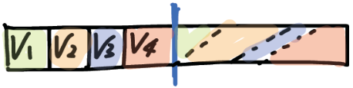
Dynamic Partition Inside Long-term Zone
Last n epoch
VM1 | VM2 | VM3 | VM4
…
Last 2 epoch
VM1 | VM2 | VM3 | VM4
Last 1 epoch
VM1 | VM2 | VM3 | VM4
Current epoch (top size of long-term zone hot bins)
VM1 | VM2 | VM3 | VM4
Predict
Convolutional weight function for history:
Next epoch
VM1 | VM2 | VM3 | VM4
VM1 | VM2 | VM3 | VM4
VM1 | VM2 | VM3 | VM4
VM1 | VM2 | VM3 | VM4
Notes:
Assume here is the current epoch access history of four VMs.
Based on each VM’s popularity, we predict next epoch as:
But according to our evaluation, one epoch is not strong enough to predict and may mislead by spikes
Therefore, we use one more epoch’s access history to refine the predict,
So on and so forth, but we need to use a convolutional weight function assign recent epoch more weights.

Slide 14
Contents
Background and Motivation
Design of GREM
Evaluation and Validation
Conclusion
Notes:
We characterize the write ampliﬁcation (WA) of SSDs as a function of fraction of sequential writes in a workload.
We plug this WAF function into our proposed Total Cost of Ownership (TCO) model, which also considers capital and operational cost, estimated lifetime of Flash under different workloads, resource restrictions and performance QoS.
Based on the TCO model, we build the online workload allocation algorithm minTCO and minTCO-Perf algorithms.
Experimental results show that minTCO reduces the ownership cost, and minTCO-Perf further balances the load among disks and maximize the overall resource utilization, while keeping the TCO as low as possible.

Slide 15




Evaluation Setups
VM
VM
VM
Trace-Driven Evaluation
Microsoft Research Cambridge
Florida International University
University of Mass Amherst
VM
VM
VM
VMware ESXi Hypervisor
Cold
Hot
Backend Cold Data
Cache Hot Data
HDD
SSD
Performance Metrics
Performance: I/O Hit Ratio
Overhead: I/O Cost
Different Caching Algorithms
Globe-LRU
CAR
VFRM
GREM
Notes:
We conduct trace-driven evaluation on real industrial workloads from MRS, FIU and UMASS. Our testbed is based on Vmware ESXi hypervisor. We compare our algorithm with Global LRU, CAR and VFRM. IO hot ratio is used for performance measurement, and IO update cost is used to calculate overhead.
Overall Perf.
HR, Cost
Followed by that, online partitions and bursty detection

Slide 16

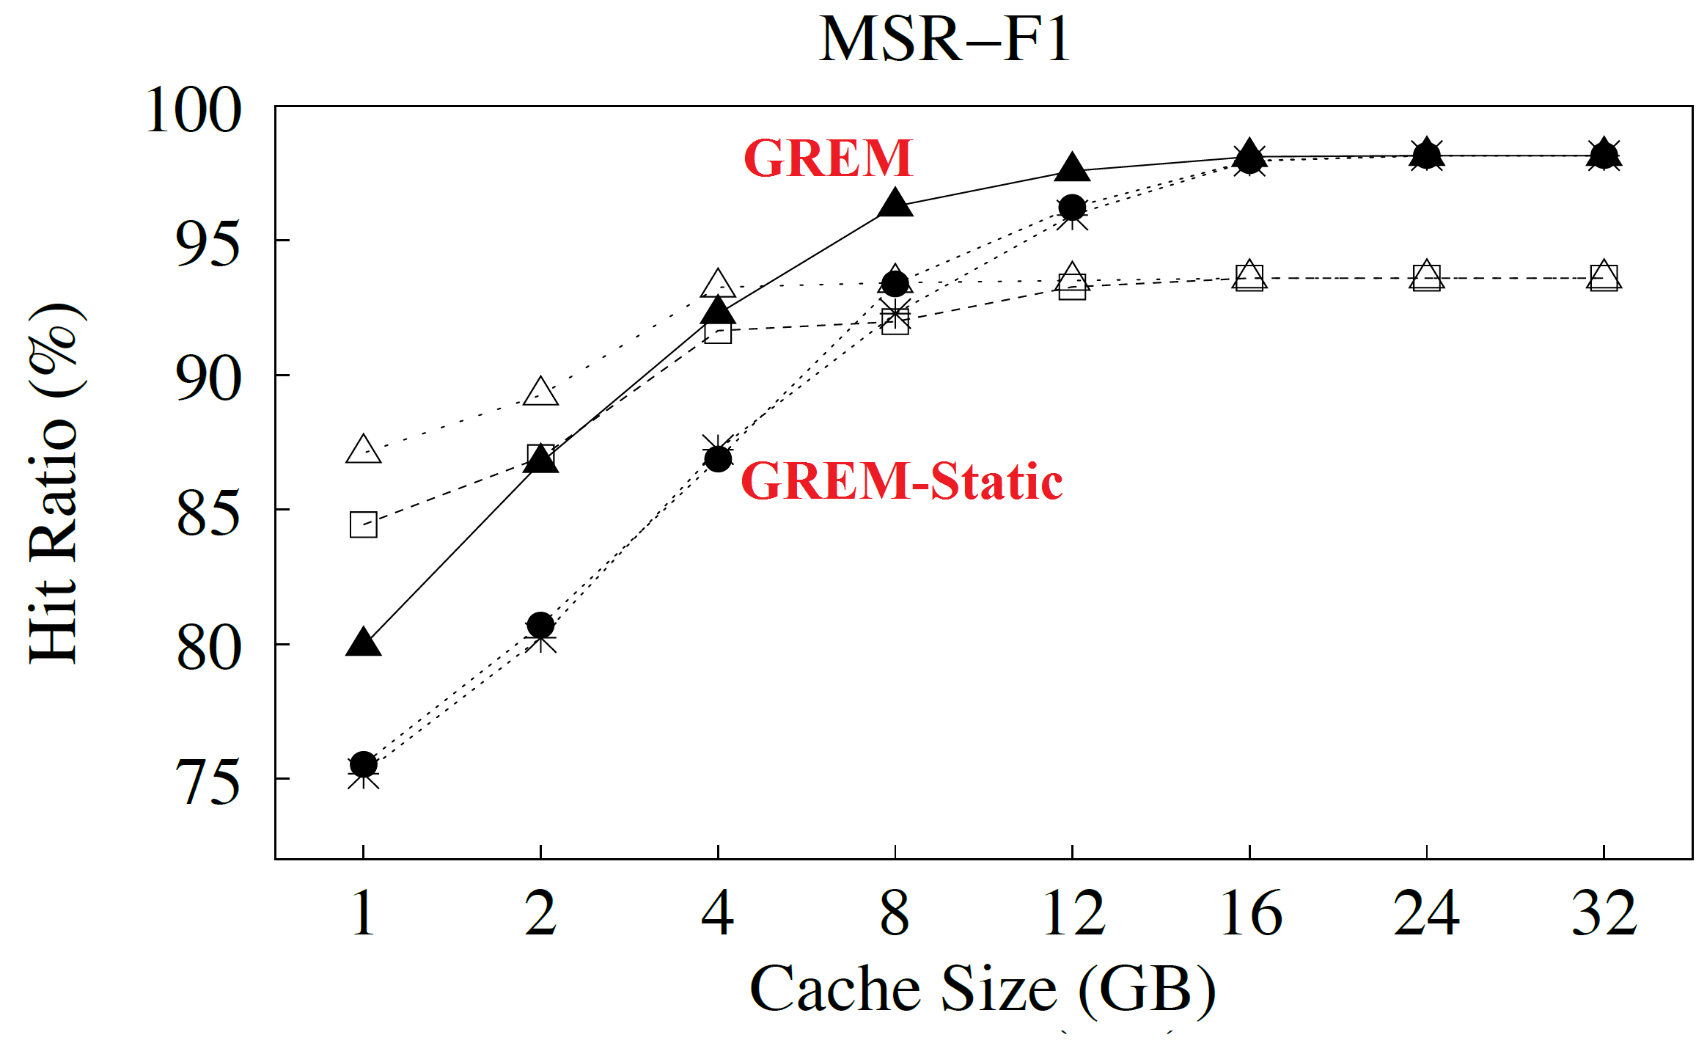
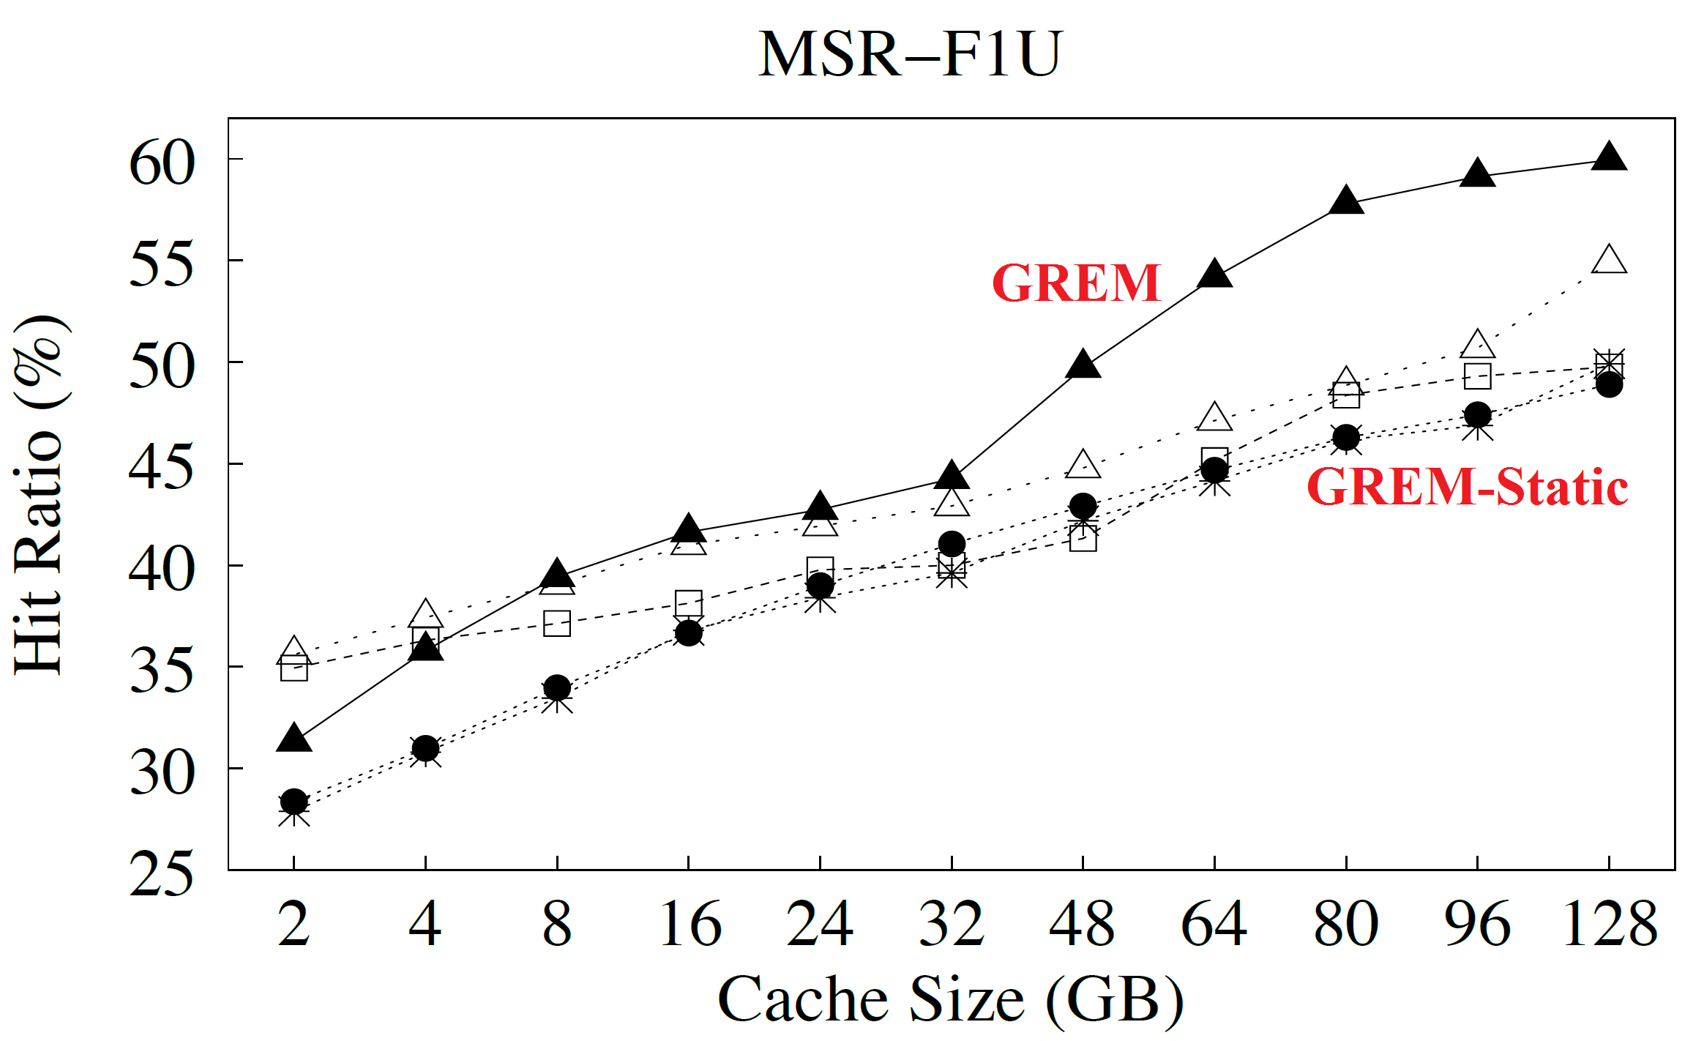

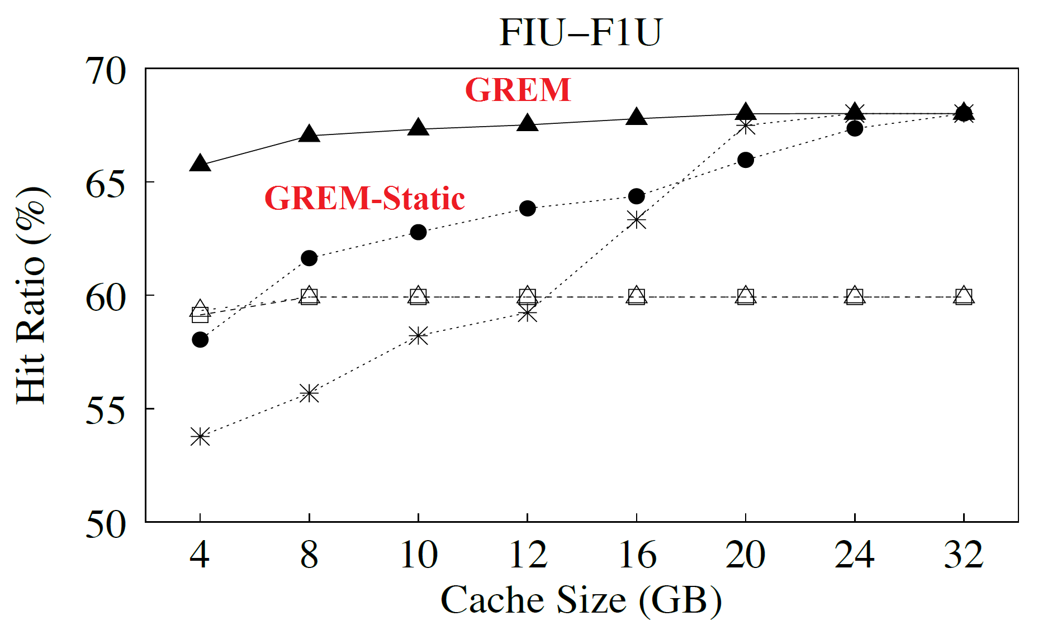
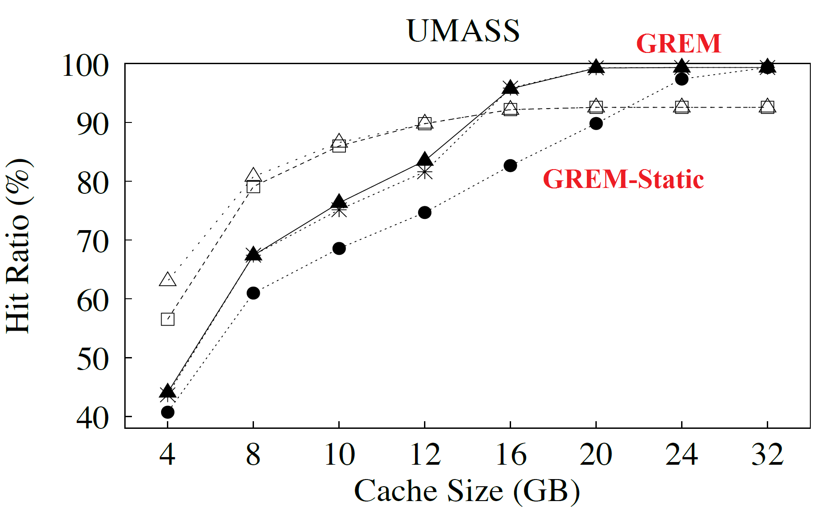
[Evaluation 1] IO Hit Ratio Results
MSR (4 Friendly)
MSR (4 Friendly + 4 Unfriendly)
FIU (4 Friendly+4Unfriendly)
Notes:
Cache small traditional algorithms are better reason:
Lazy and asycn + window update -> cannot beat sycn and fine grained traditional algorithms.
Cache larger, benefit becomes more visible under CU case
FIU even cache is small, hit ratio is still good

Slide 17
[Evaluation 2] I/O Update Cost Evaluation
I/O Update Cost = IO Access Cost + Flash Contents Update Cost
RAM
UserBuffer
SSDr
SSDw
HDDw
SSD
Cache
HDDr
SSDr + HDDw
SSDr + HDDw
HDD
Backend Storage
Notes:
Besides HR we also consider the overhead.
Here is the way we calculate the IO costs.
It is broken into two parts:
1. IOs btw RAM (userBuffer) and disks are considered as IO access cost, which is the necessary part for any storage solutions.
2. IOs btw SSD and HDD are considered as additional overheads.

Slide 18
[Evaluation 2] I/O Update Costs
GREM-Static
GREM
Notes:
We observe that our GREM can achieve at most reduce 87% IO costs compared to GLRU.
Low cost is due to the fact that GREM absorbs useful data to SSD and one-time use spikes in HDD.

Slide 19
Contents
Background and Motivation
Design of GREM
Evaluation and Validation
Conclusion
Notes:
We characterize the write ampliﬁcation (WA) of SSDs as a function of fraction of sequential writes in a workload.
We plug this WAF function into our proposed Total Cost of Ownership (TCO) model, which also considers capital and operational cost, estimated lifetime of Flash under different workloads, resource restrictions and performance QoS.
Based on the TCO model, we build the online workload allocation algorithm minTCO and minTCO-Perf algorithms.
Experimental results show that minTCO reduces the ownership cost, and minTCO-Perf further balances the load among disks and maximize the overall resource utilization, while keeping the TCO as low as possible.

Slide 20
Conclusion
Improve:
  Performance: maximize the I/O hit ratio.
  Overhead: minimize the I/O costs.
Splits the SSD into two zones:
  Long-term: performance isolation, reserve space for each VM.
  Short-term: fair compete, absorb bursties
  Methodology:
    Feedbacks of workload changes and allocation performance
    GREM dynamically adjusts the partitions:
    Between long-term and short-term zones
    Inside long-term zone (per VM)
Evaluation:
  Improve overall IO hit ratio and cost.
  Adapt to workload changes by dynamical partitions.
Notes:
Improve both performance and overhead:
maximize the I/O hit ratio.
minimize the I/O costs.
Splits the entire SSD space into two zones:
Long-term: performance isolation, reserve space for each VM.
Short-term: fair compete, absorb bursties
Methodology:
Leveraging the feedback of workload changes and allocation performance, GREM can dynamically adjust the partitions:
Inside long-term zone (per VM)
Between long-term and short-term zones
Evaluation shows that GREM can:
Utilize beneﬁts of SSDs and improve overall IO hit ratio and cost.
Detect and quickly adapt to workload changes by shifting SSD resources between and inside two zones.

Slide 21






35th IEEE International Performance Computing
and Communications Conference
IPCCC 2016, Las Vegas, Nevada, USA
Thanks
Q & A
Zhengyu Yang Jianzhe Tai Janki Bhimani Jiayin Wang Ningfang Mi Sheng Bo

