Slide 1


H-NVMe: A Hybrid Framework of NVMe-based Storage System in Cloud Computing Environment
36th IEEE International Performance Computing
and Communications Conference
IPCCC 2017, San Diego, California, USA.
Zhengyu Yang ^{[1]}, Morteza Hoseinzadeh ^{[2]}, Ping Wong ^{[3]},
John Artoux ^{[3]}, Clay Mayers ^{[3]}, David Evans ^{[3]}, Rory Bolt ^{[3]},
Janki Bhimani ^{[1]}, Ningfang Mi ^{[1]}, and Steven Swanson ^{[2]}
^{[1]} Dept. of Electrical & Computer Engineering, Northeastern University, MA
^{[2]} Dept. of Computer Science & Engineering, University of California San Diego, CA
^{[3]} Samsung Semiconductor Inc., Memory Solutions Research Lab, San Diego, CA

Slide 2

Outline
1. Background and Motivation
2. Hybrid Framework Design
3. Implementation Overview
4. Performance Evaluation
5. Conclusion

Slide 3
Outline
1. Background and Motivation
2. Hybrid Framework Design
3. Implementation Overview
4. Performance Evaluation
5. Conclusion

Slide 4
Cloud Computing Era
Patient Time
People can’t wait!
~ 30 sec
~ 15 sec
~ 5 sec
?
~ 1 sec
Baby Boomers
Generation X
Millennials
Generation Z
Generation ?
Notes:
In the era of cloud computing, researchers found that people’s patient time are different across generations.
e.g., Baby Boomers can wait for 30 sec for a phone ring or TV remote operation, while younger people can wait less.
Generation Z, the iphone generation can no longer tolerate larger than 1 sec responses.
How about the future? VR, even 1 sec is too much.
So we conclude that people can’t wait!

Slide 5


Backend Infrastructure
Framework for Applications in Big Data Era (2017)
User
Cloud
It’s all about I/O!
Virtualized Servers
I/O
Data Process
Engine
I/O
I/O
I/O
NoSQL DB
Machine Learning Analytics
Real Time Batch
Streaming
Notes:
Let’s take a look at the backend infrastructure of cloud computing and see what is the main bottleneck.
User applications send requests through the cloud, and the datacenter has thousands of virtualized servers hosting the backend programs to serve user requests.
Inside these VMs, data process engines needs to talk with NoSQL databases, machine learning apps, and even real time batch streaming apps.
All these apps triggers huge amount of I/Os and I/O in fact is the bottleneck of the cloud computing, and solving that can shorten the waiting time.

Slide 6
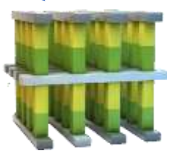
Storage Device Evolution
Write Latency and Cost Per GB Comparison
4.68$/GB
4.50$/GB
DRAM
nanosec
0.57$/GB
0.30$/GB
3D XPoint
10μs
0.28$/GB
NVMe SSD
20μs
On your mark!
0.25$/GB
MLC SSD
750μs
TLC SSD
1125μs
HDD
10ms
Data Storage
CPU Cache
Notes:
We see the storage dev evolution roadmap.
Both price & IO perf keeps increasing from traditional HDD, multiple end of SSDs, to 3D Xpoint and DRAM.
Draw line, left data storage, right CPU cache.
We see a sweet spot here, the NVMe SSD.
High perf and affordable costs make it pop in these days datacenter.

Slide 7
What is NVMe?
Max 600MB/s
AHCi
SATA Cable
SATA SSD
Max >4GB/s
NVMe
PCIe Bus
Server Motherboard
Fully utilized?
NVMe SSD
Solution | AHCi | NVMe
Full Name | Advance Host Controller Interface | Non-Volatile Memory Express
Interface | SATA | PCIe
Queue # | 1 | Up to 64K
Commands # / Queue | Up to 32 | Up to 64K
Bandwidth | 600MB/s | 4GB/s
Non Valit
- Parallism 64kup queues
Higher throughput xxxx
How to use? Lead to All-flash datacenter
However, the current xxxx cannot fully utilize xxxx of NVMe devices
Notes:
So, what is NVMe, and why can reach close-to DRAM perf?
Let’s see from datacenter point of view.
Do we really fully utilize this?

Slide 8





How is NVMe SSD deployed?
I/Os Stack of VMware ESXi’s Implementation
User | APP | APP | APP
 | GuestOS | GuestOS | GuestOS
Hypervisor | VM Monitor
 | vSCSI
 | ESX Storage Stack
Storage Device | Driver
 | Host Bus Adapter
 | Fabric
 | NVMe Controller
VM
VM
VM
DRAM
Storage Pool
Notes:
To answer this question, take look at how it is deployed.
Here is a soft/hardware stack of a pop platform VMware ESXi.
3 layers.
VM run app, hosted by hyper, DRAM to cache, NVMe as backend storage.

Slide 9
What is the problem?
I/Os Stack of VMware ESXi’s Implementation
User | APP | APP | APP
 | GuestOS | GuestOS | GuestOS | [1] World Queue
Hypervisor | VM Monitor
 | vSCSI
 | ESX Storage Stack |  |  | [2] Adapter Queue
Storage Device | Driver
 | Host Bus Adapter
 | Fabric
 | NVMe Controller
IOServ
[3] Device Queue
Up to 64K queues
Notes:
What’s the problem?
There are lots of intermediate queues.
To simplify the problem, we only show major queues, in fact more.

Slide 10
What is the problem?
I/Os Stack of VMware ESXi’s Implementation
User | APP | APP | APP
 | GuestOS | GuestOS | GuestOS | [1] World Queue
Hypervisor | VM Monitor
 | vSCSI
 | ESX Storage Stack |  |  | [2] Adapter Queue
Storage Device | Driver
 | Host Bus Adapter
 | Fabric
 | NVMe Controller
IOServ
[3] Device Queue
Up to 64K queues
Notes:
IO generated from VM

Slide 11
What is the problem?
I/Os Stack of VMware ESXi’s Implementation
User | APP | APP | APP
 | GuestOS | GuestOS | GuestOS | [1] World Queue
Hypervisor | VM Monitor
 | vSCSI
 | ESX Storage Stack |  |  | [2] Adapter Queue
Storage Device | Driver
 | Host Bus Adapter
 | Fabric
 | NVMe Controller
Consolidation
IOServ
[3] Device Queue
Up to 64K queues
Notes:
Consolidate to adapter queue

Slide 12
What is the problem?
I/Os Stack of VMware ESXi’s Implementation
User | APP | APP | APP
 | GuestOS | GuestOS | GuestOS | [1] World Queue
Hypervisor | VM Monitor
 | vSCSI
 | ESX Storage Stack |  |  | [2] Adapter Queue
Storage Device | Driver
 | Host Bus Adapter
 | Fabric
 | NVMe Controller
Consolidation
IOServ
[3] Device Queue
Up to 64K queues
Notes:
IOServ in NVMe driver strives to dispatch them into queues in NVMs device

Slide 13
What is the problem?
I/Os Stack of VMware ESXi’s Implementation
User | APP | APP | APP
 | GuestOS | GuestOS | GuestOS | [1] World Queue
Hypervisor | VM Monitor
 | vSCSI
 | ESX Storage Stack |  |  | [2] Adapter Queue
Storage Device | Driver
 | Host Bus Adapter
 | Fabric
 | NVMe Controller
Consolidation
IOServ
[3] Device Queue
Up to 64K queues
Notes:
One by one

Slide 14
What is the problem?
I/Os Stack of VMware ESXi’s Implementation
User | APP | APP | APP
 | GuestOS | GuestOS | GuestOS | [1] World Queue
Hypervisor | VM Monitor
 | vSCSI
 | ESX Storage Stack |  |  | [2] Adapter Queue
Storage Device | Driver
 | Host Bus Adapter
 | Fabric
 | NVMe Controller
Consolidation
IOServ
[3] Device Queue
Up to 64K queues

Slide 15
What is the problem?
I/Os Stack of VMware ESXi’s Implementation
User | APP | APP | APP
 | GuestOS | GuestOS | GuestOS | [1] World Queue
Hypervisor | VM Monitor
 | vSCSI
 | ESX Storage Stack |  |  | [2] Adapter Queue
Storage Device | Driver
 | Host Bus Adapter
 | Fabric
 | NVMe Controller
IOServ
[3] Device Queue
Up to 64K queues

Slide 16
What is the problem?
I/Os Stack of VMware ESXi’s Implementation
User | APP | APP | APP
 | GuestOS | GuestOS | GuestOS | [1] World Queue
Hypervisor | VM Monitor
 | vSCSI
 | ESX Storage Stack |  |  | [2] Adapter Queue
Storage Device | Driver
 | Host Bus Adapter
 | Fabric
 | NVMe Controller
Locked
Wait for completion
IOServ
[3] Device Queue
Up to 64K queues
Notes:
Adapter queue will be locked, and it starts to wait for completion.
So far so good, right? But…

Slide 17
What is the problem?
I/Os Stack of VMware ESXi’s Implementation
User | APP | APP | APP
 | GuestOS | GuestOS | GuestOS | [1] World Queue
Hypervisor | VM Monitor
 | vSCSI
 | ESX Storage Stack |  |  | [2] Adapter Queue
Storage Device | Driver
 | Host Bus Adapter
 | Fabric
 | NVMe Controller
Locked
Wait for completion
IOServ
[3] Device Queue
Up to 64K queues
Notes:
Now we have more new IOS coming

Slide 18
What is the problem?
I/Os Stack of VMware ESXi’s Implementation
User | APP | APP | APP
 | GuestOS | GuestOS | GuestOS | [1] World Queue
Hypervisor | VM Monitor
 | vSCSI
 | ESX Storage Stack |  |  | [2] Adapter Queue
Storage Device | Driver
 | Host Bus Adapter
 | Fabric
 | NVMe Controller
Consolidation
Locked
Wait for completion
Blocked
Send Completion signal
IOServ
[3] Device Queue
Finished
Wasted
Up to 64K queues
Notes:
Again, merge, then Oops, blocked, and 64k queues are wasted.
Until finished and completion signal is sent. Unlock.

Slide 19
What is the problem?
I/Os Stack of VMware ESXi’s Implementation
User | APP | APP | APP
 | GuestOS | GuestOS | GuestOS | [1] World Queue
Hypervisor | VM Monitor
 | vSCSI
 | ESX Storage Stack |  |  | [2] Adapter Queue
Storage Device | Driver
 | Host Bus Adapter
 | Fabric
 | NVMe Controller
Unlocked
IOServ
[3] Device Queue
Up to 64K queues
Notes:
Now IOServ can start to dispatch.

Slide 20
What is the problem?
I/Os Stack of VMware ESXi’s Implementation
User | APP | APP | APP
 | GuestOS | GuestOS | GuestOS | [1] World Queue
Hypervisor | VM Monitor
 | vSCSI
 | ESX Storage Stack |  |  | [2] Adapter Queue
Storage Device | Driver
 | Host Bus Adapter
 | Fabric
 | NVMe Controller
IOServ
[3] Device Queue
Up to 64K queues
Notes:
There are lots of intermediate queues

Slide 21

Problems and Implications
Problem 1: Too many intermediate queues.
=> Redundant consolidation and dispatching operations.
Improve these queues?
Problem 2: Queue operations are not lock-free.
=> Waiting for completions is a big waste of time.
Lock-free?
Problem 3: There is only one “IOServ” dispatcher.
=> Cannot fully utilize up-to 64K queues in NVMe.
More “IOServ”s?
Notes:
So to sum up, there are 3 problems in the current architecture.

Slide 22
Outline
1. Background and Motivation
2. Hybrid Framework Design
3. Implementation Overview
4. Performance Evaluation
5. Conclusion

Slide 23
First things first
Design Goals:
  Improve I/O stack by removing locks
  Fully utilize up-to 64K queues in NVMe disk
Implementation Focus:
  VMware ESXi 6.0.0 (Kernel and IOFilter)
  Samsung NVMe driver
Approaches:
  Compatible: Parallel Queue Mode
  Aggressive: Direct Access Mode

Slide 24
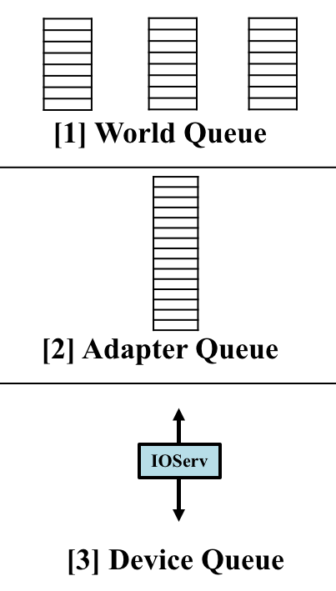
H-NVMe: Two-mode Framework Design
Current
New Mode 1
New Mode 2
Original I/O Stack
APIs
Empty
This Queue
Full Control
1. Empty the queue
1. Attach IOFilter
2. Customized device queues
2. Forward to NVMe
3. Multiple IOServs
3. Multiple IOServs
Notes:
Here is an overview of our two modes, comparing with the original design.
We have limited control of hypervisor thru APIs, but we have full control of the NVMe driver.
Thus, ur 1st idea is to empty adapter queue by taking everything from it to our customized device queue, and also multiple IOServs to fully utilize NVMe queues.
The second mode is more aggressive. We bypass all these queues and directly bridge VM Ios with device queues and multi IOServs.
VAIO (vSphere APIs for IOFiltering)
Solution: H-NVMe offers two modes to deploy VMs:
[Parallel Queue Mode] Increase parallelism Enable lock-free operations by forwarding jobs from the Adapter Queue to the our proposed enhanced subqueues in the driver. A generalized solution, relatively straightforward to implement.
[Direct Access Mode] allows trusted applications with VAIO IOFilter attached to their user VMDKs to directly access NVMe SSDs and bypass the entire I/O stack in the hypervisor layer to further ensure performance isolation, which suits premium users who have higher priorities and the permission to attach IOFilter to their VMDKs.

Slide 25
H-NVMe: Two-mode Framework Design
Current
New Mode 1
New Mode 2
Original I/O Stack
Pros:
- Easy to implement
- Better compatibility
Pros:
- Aggressive approach
- Better performance isolation
- Higher I/O speed
APIs
Empty
This Queue
Full Control
Cons:
- Still has queues
Cons:
  - Breaks encapsulation
  - Open NVMe to users
1. Empty the queue
1. Attach IOFilter
Deploy Policy: Only allow trusted (premium or higher SLA) users to use DAM mode!
2. Customized device queues
2. Forward to NVMe
3. Multiple IOServs
3. Multiple IOServs
Notes:
To sum up, 1st mode is xx but xx
On the other hand, 2nd mode is xxx but xxx
How to deploy? We only xxx

Slide 26
Example of 1st New Mode PQM
User | APP | APP | APP
 | GuestOS | GuestOS | GuestOS | [1] World Queue
Hypervisor | VM Monitor
 | vSCSI
 | ESX Storage Stack |  |  | [2] Adapter Queue
Storage Device | Driver
 | Host Bus Adapter
 | Fabric
 | NVMe Controller
Our
Queues
IOServ
IOServ
IOServ
Up to 64K queues
Notes:
Let’s see an example of 1st mode.

Slide 27
Example of 1st New Mode PQM
User | APP | APP | APP
 | GuestOS | GuestOS | GuestOS | [1] World Queue
Hypervisor | VM Monitor
 | vSCSI
 | ESX Storage Stack |  |  | [2] Adapter Queue
Storage Device | Driver
 | Host Bus Adapter
 | Fabric
 | NVMe Controller
Consolidation
Send fake
Completion signal
Unlocked
Our
Queues
IOServ
IOServ
IOServ
Up to 64K queues
Notes:
After merging, we send fake signal to unlock the adapter queue.

Slide 28
Example of 1st New Mode PQM
User | APP | APP | APP
 | GuestOS | GuestOS | GuestOS | [1] World Queue
Hypervisor | VM Monitor
 | vSCSI
 | ESX Storage Stack |  |  | [2] Adapter Queue
Storage Device | Driver
 | Host Bus Adapter
 | Fabric
 | NVMe Controller
Polling:
Winner takes all
Unlocked
Our
Queues
IOServ
IOServ
IOServ
Dispatch
Up to 64K queues
Notes:
We implement the “winner takes all” polling policy.
The first idle IOServ and queue takes over everything from adapter queue and dispatch to NVMe queues.

Slide 29
Example of 1st New Mode PQM
User | APP | APP | APP
 | GuestOS | GuestOS | GuestOS | [1] World Queue
Hypervisor | VM Monitor
 | vSCSI
 | ESX Storage Stack |  |  | [2] Adapter Queue
Storage Device | Driver
 | Host Bus Adapter
 | Fabric
 | NVMe Controller
Unlocked
Our
Queues
IOServ
IOServ
IOServ
Dispatch
Up to 64K queues

Slide 30
Example of 1st New Mode PQM
User | APP | APP | APP
 | GuestOS | GuestOS | GuestOS | [1] World Queue
Hypervisor | VM Monitor
 | vSCSI
 | ESX Storage Stack |  |  | [2] Adapter Queue
Storage Device | Driver
 | Host Bus Adapter
 | Fabric
 | NVMe Controller
Polling:
Winner takes all
Unlocked
Our
Queues
IOServ
IOServ
IOServ
Dispatch
Up to 64K queues
Notes:
Now comes the second wave of IOs.

Slide 31
Example of 1st New Mode PQM
User | APP | APP | APP
 | GuestOS | GuestOS | GuestOS | [1] World Queue
Hypervisor | VM Monitor
 | vSCSI
 | ESX Storage Stack |  |  | [2] Adapter Queue
Storage Device | Driver
 | Host Bus Adapter
 | Fabric
 | NVMe Controller
Unlocked
Our
Queues
IOServ
IOServ
IOServ
Dispatch
Up to 64K queues
Notes:
Assume the 2nd queue takes all.

Slide 32
Example of 1st New Mode PQM
User | APP | APP | APP
 | GuestOS | GuestOS | GuestOS | [1] World Queue
Hypervisor | VM Monitor
 | vSCSI
 | ESX Storage Stack |  |  | [2] Adapter Queue
Storage Device | Driver
 | Host Bus Adapter
 | Fabric
 | NVMe Controller
Unlocked
Our
Queues
IOServ
IOServ
IOServ
Dispatch
Up to 64K queues
Notes:
Dispatch

Slide 33
Example of 2nd New Mode DAM
User | APP | APP | APP
 | GuestOS | GuestOS | GuestOS
Hypervisor | VM Monitor
 | vSCSI
 | ESX Storage Stack
Storage Device | Driver
 | Host Bus Adapter
 | Fabric
 | NVMe Controller
IOFilter
IOFilter
IOFilter
Private
Channels
VAIO
IOFilter
Handle
Handle
Handle
Bypass
Default
I/O Stack
Space
Mapping
Expose the NVMe SSD to VMs
Device
Queue
IOServ
IOServ
IOServ
Direct
Access
Up to 64K queues
Notes:
Let’s see the example of DAM mode. Which is much straightforward.
Thru IOFilters, we bridge IOs from VM directly to customized queues.
Space mapping is also involved.
Again, we expose the NVMe SSD to users. Which is aggressive and risky but will speed up.

Slide 34
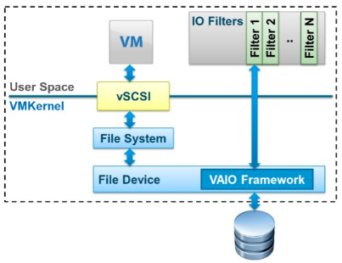
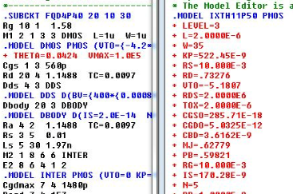
Highlighted Features of 2nd New Mode DAM
Allows multiple users to share a NVMe SSD.
Daemon IOFilter attached to VMs => VAIO program to handle and forward I/Os directly to NVMe.
Not require every single application to link with a 3rd party library (e.g., Intel’s SPDK) and be recompiled.
Transparent to user application (VM-granularity).
Notes:
Here’s some xx of DAM.

Slide 35
Outline
1. Background and Motivation
2. Hybrid Framework Design
3. Implementation Overview
4. Performance Evaluation
5. Conclusion

Slide 36

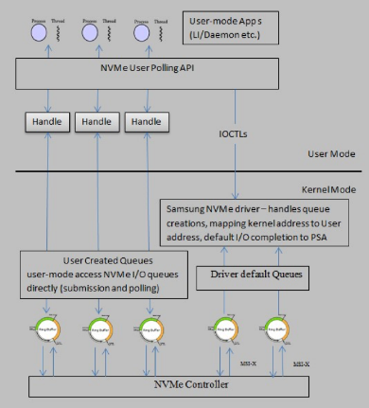
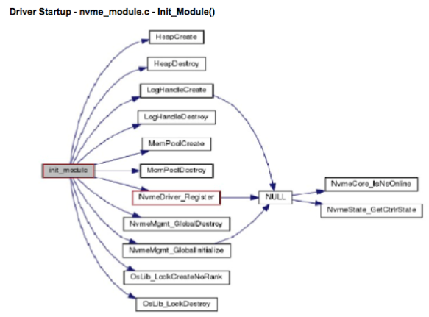
Implementation
  VAIO IOFilter
VM
VM
VM
VM
VM
VM
VMware ESXi Hypervisor
  User Polling Scheme
  NVMe Driver
Notes:
We conduct real implementation based on VMware ESXi hypervisor 6.0.0.
We modified IOFilter,
customized user polling scheme,
rewrote couple modules in the NVMe driver.

Slide 37
Outline
1. Background and Motivation
2. Hybrid Framework Design
3. Implementation Overview
4. Performance Evaluation
5. Conclusion

Slide 38



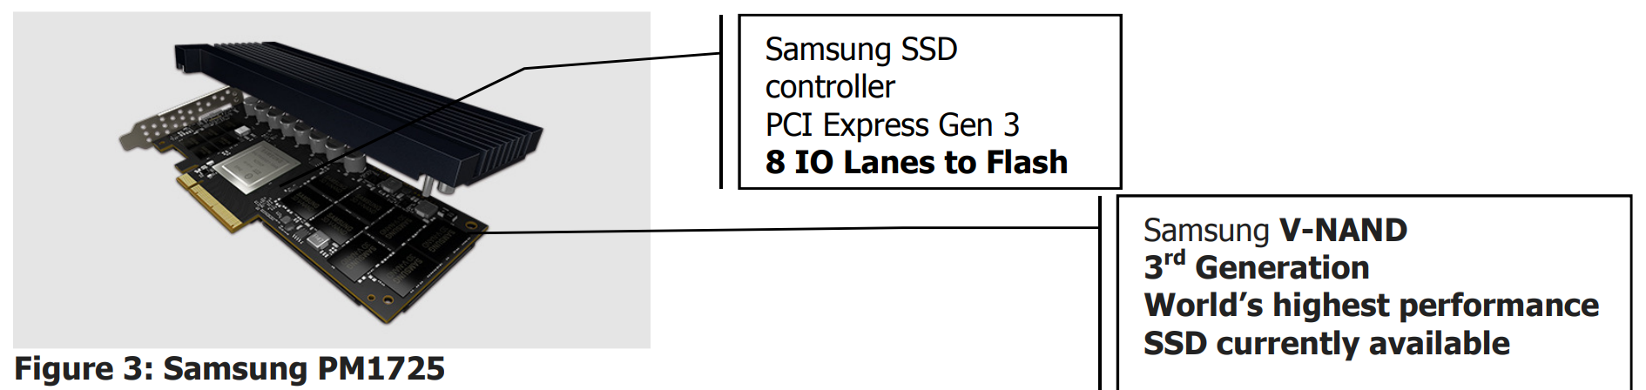
Evaluation Setups
Architecture
Host Server Configuration
VM
VM
VM
VM
VM
VM
VMware ESXi Hypervisor
Notes:
No more than 10% are following DAM.

Slide 39
      Bandwidth and Latency of Read/Write Mixed Workloads
7 different VMs running different workloads
[Obv.1] H-NVMe achieves better performance in majority of cases.
[Obv.2] Small block size workloads, H-NVMe performs much better.
[Obv.3] Size ->256KB, performance improvement -> less.
Because larger I/O => better locality => less room to improve.
Notes:
We run 7 workloads with different average I/O sizes on 7 different VMs hosted by the same hypervisor, config overall seq% of each WLvaries from 30% to 70%.
1. Generally, H-NVMe achieves better performance in all subﬁgures.
2. Small block size workloads, H-NVMe performs much better than the original NVMe framework. Because our algorithm reduce WAF.
3. However, when workload I/O size increases to 256KB (e.g., the “256KB” bars in Fig. (b) and (e)), performance improvement becomes less.
This is because larger average I/O sizes have better locality so that there is less room for performance improvement. Similarly, once I/O size reaches 256KB, the read latency of the original NVMe is even slightly better, see in Fig. (c).

Slide 40
        Temporal and Spatial Overheads of Mixed Workloads
[Obv.1] signiﬁcantly reduces time for small I/O sizes => beneﬁcial from parallelism, reduces WAF.
[Obv.2] slightly higher spatial overhead => maintain multiple subqueues in the driver layer.
[Obv.3] I/O size increases -> gap gets smaller. Penalty of overhead < time saved.
Notes:
We submit same amount of ttl data but with diff block size. Short is better.
1. H-NVMe signiﬁcantly reduces ttl RT for those workloads with small I/O sizes. small I/O sizes are more beneﬁcial from PQM’s parallelism which reduces WAF.
2. spatial overhead by measuring the amount of data in the context switching, H-NVMe has slightly higher spatial overhead, because it needs to maintain multiple subqueues in the driver layer which requires few extra context switches.
computationally intensive,
3. Diff of their spatial overheads gets smaller when the average I/O size increases. In fact, the penalty of this extra spatial overhead is much lower than the time saved by H-NVMe. Therefore, we conclude that by eliminating the synchronization locks contention from multiple queues, HNVMe can signiﬁcantly reduce the performance overhead of the I/O stack.

Slide 41
        Stress Tests on Sequential and Random Workloads
[Exp 1] Read Intensive [Exp 2] Write Intensive
ReadCap
6000
WriteCap
2000
Gap↓
Gap↓
[Baseline] Original NVMe’s best performance (seq)
[Obv.1] SeqRead BW > Baseline, RandRead BW > Baseline
[Obv.2] SeqWrite BW > Baseline, RandWrt BW < Baseline (WAF)
[Obv.3] After 16KB, SeqRead BW, SeqWrite BW => Device Capacity
[Obv.4] Gap ↓ btw RandRead / RandWrt to SeqRead / SeqWrt => WAF↓ Queuing Bottlenecks ↓
Notes:
To further investigate the boundary performance improvement brought by H-NVMe under extreme cases, we conduct several stress tests on read- and write-intensive, pure sequential and random workloads in this subsection.
We use the original NVMe’s sequential read and write as the benchmark baseline, which reﬂects the read and write steady states (i.e., the “upper bound”) under the original NVMe framework.
We ﬁrst present the study on the read-intensive workloads. From Fig. (a), we observe that H-NVMe has higher throughput and bandwidth in both sequential and random read than the original NVMe upper bound, which validates the effectiveness of H-NVMe.
Furthermore, once the average I/O size is greater than 16KB, H-NVMe’s sequential read bandwidth is close to the device capacity (i.e., 6,000 MBPS), and meanwhile, the original NVMe cannot reach that point even at the datapoint of 128KB, see Fig. 6(b).

Slide 42
Outline
1. Background and Motivation
2. Hybrid Framework Design
3. Implementation Overview
4. Performance Evaluation
5. Conclusion

Slide 43
Conclusion
Goal:
  Address limitation of current NVMe deployment.
  Too many non lock-free queues => 64k queues in NVMe wasted.
Proposed:
  A hybrid framework (PQM>Parallelism, DAM>Direct).
Implement:
  H-NVMe on VMware ESXi.
Finding:
  H-NVMe framework outperforms the original NVMe solution under multiple benchmarks.
Future Work:
  Optimize for machine learning apps.
  Support KVM and Xen.
Notes:
Proposed: A hybrid framework H-NVMe
Goal: to better utilize NVMe SSDs in the modern superscale cloud computing datacenters.
Motivation: bottlenecks caused by multiple intermediate queues in the current deployment of NVMe in the VM-hypervisor environment, cannot fully utilize the maximum performance throughput (up to 64K in depth) of NVMe resources.
Solution: H-NVMe offers two modes to deploy VMs:
[Parallel Queue Mode]
Increase parallelism
Enable lock-free operations by forwarding jobs from the Adapter Queue to the our proposed enhanced subqueues in the driver.
A generalized solution, relatively straightforward to implement.
[Direct Access Mode] allows trusted applications with VAIO IOFilter attached to their user VMDKs to directly access NVMe SSDs and bypass the entire I/O stack in the hypervisor layer to further ensure performance isolation, which suits premium users who have higher priorities and the permission to attach IOFilter to their VMDKs.
Implement: H-NVMe on VMware ESXi
Evaluation: reuslts show that our proposed framework outperforms the original NVMe solution under multiple benchmarks.

Slide 44
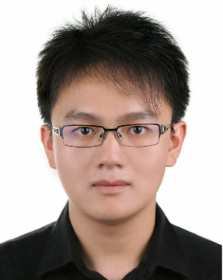






Q & A
Thanks
Z. Yang M. Hoseinzadeh P.Wong J. Artoux C. Mayers
D. Evans R. Bolt J. Bhimani N. Mi S. Swanson

Slide 45
Backup Slides
Backup Slides

Slide 46
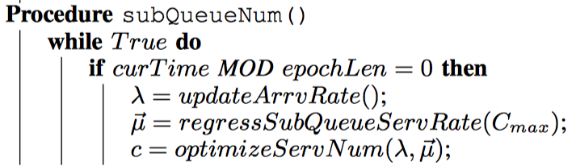
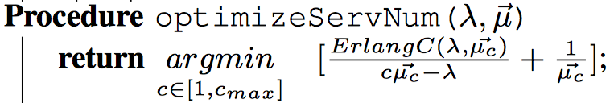
Why not having unlimited IOServs and Driver queues?
IOServ
IOServ
IOServ
IOServ
IOServ
IOServ
… ?
IOServ = thread => limited DRAM+CPU SoC resources
Each IOServ’s ServRate and IOServ# => not linear
Periodically calibrate ServRateVector
Select IOServ# that leads to the lowest average latency

Slide 47
Evaluation Setups
Performance Metrics
  1. Throughput (IOPS)
  2. Bandwidth (MBPS)
  3. I/O Latency (Sec)
Tested Algorithms
  1. Original kernel-based inbox algorithm
  2. H-NVMe framework with dynamic IOServ (at most 10% DAM)
Workloads (FIO)
  1. Performance of read/write mixed workloads
  2. Overheads of read/write mixed workloads
  3. Stress tests on sequential and random workloads

