Slide 1
Assessing the Performance Impact of Scheduling Policies in Spark
MaryAshley Etefia
Computer Science Major
University of Georgia
Professor Ningfang Mi
Mentor Zhengyu Yang
NSF REU Award 1559894
Notes:
This summer i worked under Prof...
I had the assistance of my grad…
And i worked on a project entitled….

Slide 2
Background + Keywords
Spark is a real-time data processing framework
Resilient distributed datasets (RDD) are fixed storage spaces
RDD Dependency
Scheduling policies decide when and where
Cloud engineers and managers at data centers looking for ways to optimize memory resources for their customers
Notes:
Shiift from Hadoop MapReduce (batch - organizing old stored data) to spark
...within the Stages of a Spark application……. Rdd dep. Is relationship between rdds
Scheduling policies decide when resources will be used and where they will go

Slide 3
Goals
To identify which workloads have a wide or narrow RDD dependency
To determine which scheduling policy is optimal for workloads that are running simultaneously
Notes:
The difference between a narr… Wide (executes more shuffling)
- Now, Two types of policies are fair and fifo…
- FAIR - works so that if a initial workload is running, workloads submitted in between will still receive resources w/o waiting longer
- FIFO- dish out resources out to jobs submitted in order

Slide 4
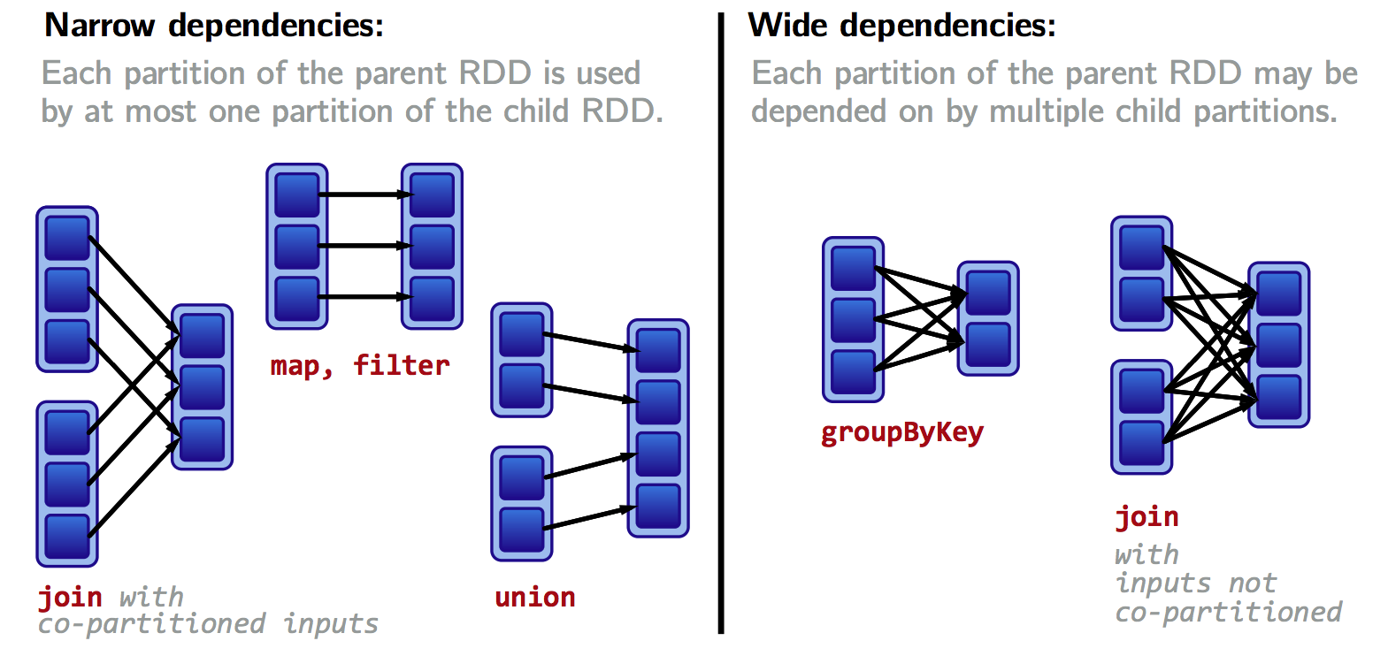
Notes:
This slide is just to give you a visual representation of wide vs narrow dependency………… lemme just point out the apparent influx of shuffling that occurs

Slide 5
State of the Art
RDD dependencies within the stages of a Spark application must be investigated
Understanding RDD dependency will help determine which scheduling policy is optimal
Notes:
So whats new?.... While memory management is nothing new……
Since stages containing rdds of a workload may be compromised/delayed when multiple workloads are running

Slide 6
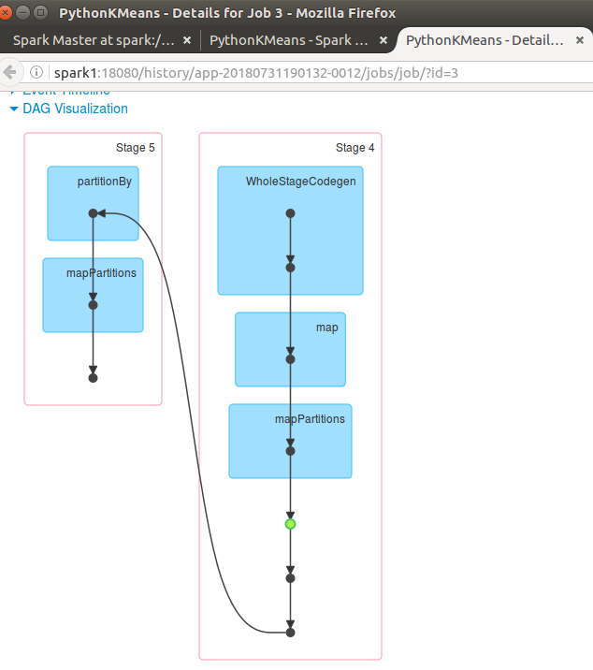
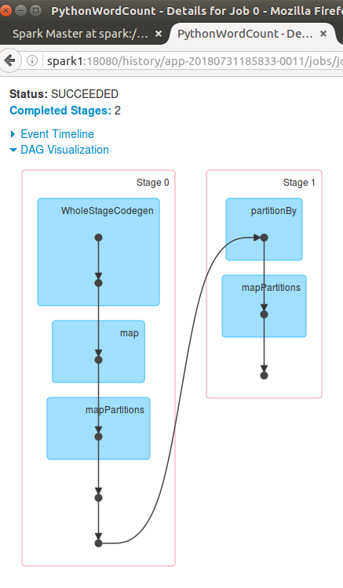
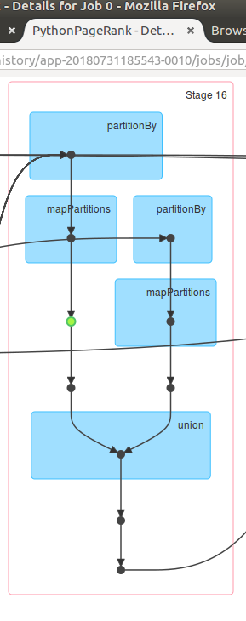
Results + Conclusion
K-Means DAG
Wordcount DAG
PageRank DAG
VS.
Narrow RDD Dependency
Wide RDD Dependency
PageRank has a wide dependency because it is evident that data is shuffled across multiple partitions or RDDs
PageRank algorithm
Notes:
I ran 3 workloads separately so that I could investigate the dag…
and as you can see…
Pagerank’s dag is probably like this because its algorithm follows a recursive definition…. so a lot of looping and linking is executed

Slide 7
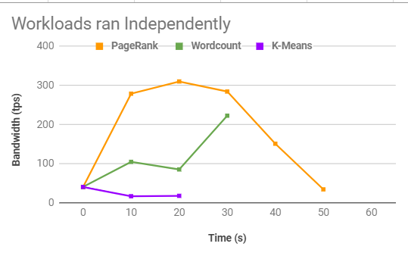
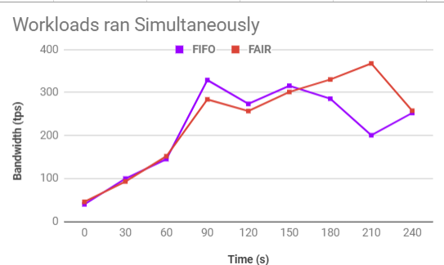
Results + Conclusion (continued)
Spark’s FAIR scheduling policy is optimal for a combination of workloads such as PageRank, K-Means, and Wordcount, since the average bandwidth for the FAIR policy was slightly higher than the FIFO policy
Average FAIR bandwidth: 232.07 tps… Average FIFO bandwidth: 215.8 tps
Notes:
This 1st graph is just for reference
Study of rdd dependencies acts as a proof/support for fifo vs fair graph

Slide 8
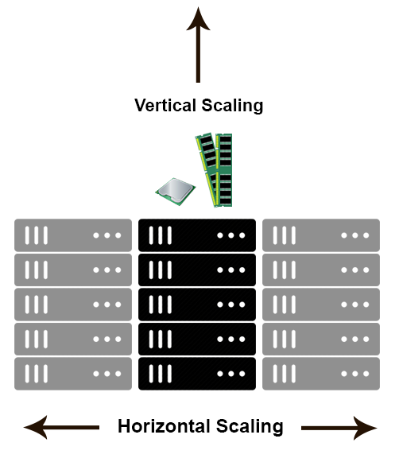
Possible Future Works
Scaling performance results of low-level Spark workloads to datasets handled by data centers
Vertical/horizontal sharding
Notes:
Future researchers/institutions can work with…
Vertical - increasing memory in already present servers
Horizontal - increasing servers

Slide 9
My Contribution
Helped set up an Apache Spark cluster
Investigated Directed Acyclic Graphs (DAGs)
Configured FAIR and FIFO scheduling policies
Notes:
With 1 master, and 4 worker nodes
while running single Spark workloads
While running multiple workloads

Slide 10
What Did I Learn?
A few tips about networking
“Client/server” model
Server operating systems
Apache Spark cluster basics
I/O tracing tools
Memory management tips
Notes:
-hypervisors
-iostat and blktrace

Slide 11
Acknowledgements
National Science Foundation
Supervisor, Melanie Smith
Professor Ningfang Mi
Graduate Mentor, Zhengyu Yang
Lab Partner, Henry Santer
Graduate Student, Mahsa Bayati
Graduate Student, Danlin Jia

