Slide 1



Accelerating Big Data Applications Using Lightweight
Virtualization Framework on Enterprise Cloud
21st IEEE High Performance Extreme Computing Conference
21st IEEE High Performance Extreme Computing Conference
Janki Bhimani Zhengyu Yang Miriam Leeser Ningfang Mi
Dept. of Electrical & Computer Engineering,
Northeastern University, Boston, MA
Sept. 14, 2017
Supported by:

Slide 2
Topics
1. Introduction
2. Virtualization Frameworks
3. Data Processing Engine
4. Evaluation
5. Conclusions and Future Work

Slide 3
Topics
1. Introduction
2. Virtualization Frameworks
3. Data Processing Engine
4. Evaluation
5. Conclusions and Future Work

Slide 4

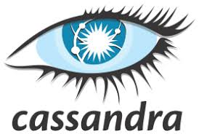
Framework for Applications in Big Data Era
Framework for Applications in Big Data Era (2017)
User
Cloud
Virtualized Servers
Data Process
Engine
NoSQL DB
Machine Learning Analytics
Real Time Batch
Streaming
Notes:
Here is an overview of the framework of applications in the big data era.
The user applications send requests through the cloud, and the datacenter has thousands of virtualized servers hosting the backend programs to serve user requests.
Two popular techniques are used in this virtualization layer: VM hypervisor and docker container.
If we go deeper into this layer, we will see that data process engines such as Hadoop and Spark are processing the data requests.
Usually it generates queries to the NoSQL DB such as RocksDB, Cassandra, Scylla and MongoDB. It also uses ML analytics applications such as TensorFlow and Torch, and real time batch streaming applications are also involved such as Kafka.
In this paper, we are focusing on the virtualization layer.
We compare traditional VM hypervisor and docker container and to guide developers to accelerate big data applciations.

Slide 5
VM Hypervisor vs. Docker
  Traditional Hypervisors vs. Emerging Containers
VM Hypervisor
Docker Container
Similar:
Resource Isolation
Parallel Allocation
Different:
Architecture
  Guest OS vs. No Guest OS
Resource Management
  Distributed vs. Shared
  Since Docker:
  Is light weight
  Has better resource utilization
  Has better scalability
  Can Docker speed-up Big Data processing platforms?
Notes:
Containers and virtual machines are two popular virtualization technologies.
Both of them provide resource isolation and parallel allocation for each VM.
However, unlike the VM hypervisor, Docker does not need to maintain guest OS for each VM.
Also, containers perform shared resource management but VMs perform distributed resource management.
So, docker is light weight, has better resource utilization and salacity, can we conclude that it can replace VM hypervisor and speed up big data processing platform?

Slide 6
Tradeoffs between Spark using VM and Docker
Applications
Execution Behavior
Resource Requirements
Private pool of allocated resources
Distributed Resource Management
Common pool of resources
Shared Resource Management
Spark using Docker
Spark using VM
Spark Flow
 | Spark on VM | Spark on Docker
Resource Utilization | Bad | Good
Cross-node Interference | Good | Bad
Stability | Good | Bad
Flexibility | Bad | Good
Security | Good | Bad
Notes:
In fact, the short answer is maybe.
Let’s first take a look at the implementation of the widely used Big Data processing framework Spark:
Spark apps can have different exe behaviors and corresponding resource requirements, such as intermediate data RDDs (# Resilient Distributed Datasets (RDDs)) and library dependencies.
Different virtualization approaches will have different performance under these Spark applications.
However, Spark has no idea of the underlying virtualization.
Furthermore, as shown in the table, both of VM and docker has their advantages and disadvantages for hosting Spark.
VM approach has better isolation ability, which is good for stability and security, but sometimes it will trigger resource wasting.
Meanwhile, Docker is more flexible of sharing the resources which helps to utilize resources in a better way, with the tradeoff of cross-node interference and security.

Slide 7
Motivation and Goal
Motivation and Goal
Compare: architecture of different virtualization frameworks for a big data enterprise cloud environment using Apache Spark.
Analyze: performance of applications running in the cloud:
  Makespan
  Execution Time
  Resource utilization (CPU, Disk, Memory etc.)
Guide: application developers, system administrators and researchers to better design and deploy big data applications on their platforms.
Notes:
% Hadoop, a widely adopted cloud computing framework in industry, has been criticized in recent years for its inefficiency of handling iterative and interactive applications.
% RDD= Resilient Distributed Datasets

Slide 8
Topics
1. Introduction
2. Virtualization Frameworks
3. Data Processing Engine
4. Evaluation
5. Conclusions and Future Work

Slide 9
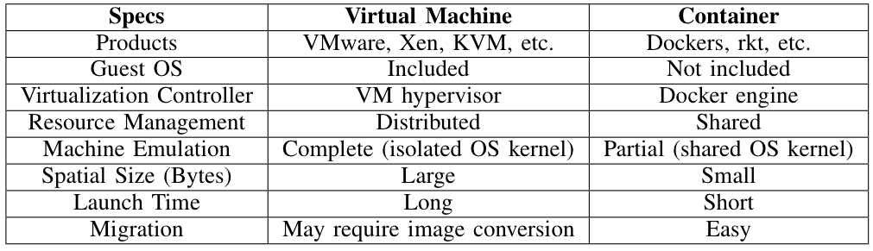
System Architecture
VM Hypervisor
Docker Container
Notes:
We see the detailed comparison of VM and Docker in two figures and the table.
To sum up, they have common components, such as the three layers: application, OS & driver, and storage
Notice that:
Docker Engine conducts flexible resource sharing feature.
Docker storage drivers is using copy-on-write policy (for docker image) which only conducts copy when you modify it, similar to Apple’s APFS.
%The data management of containers is managed by Docker storage drivers (we use AUFS).
%For fair comparison, we use Ext4 for host backing file system of both virtual machine and Docker.
% Docker has separate container workspace: filesystem and database
% Data persistence – Docker volume
% A Docker image is an inert, immutable file, from which containers are started.

Slide 10
Topics
1. Introduction
2. Virtualization Frameworks
3. Data Processing Engine
4. Evaluation
5. Conclusions and Future Work

Slide 11
Spark on VM Hypervisor and Docker
Spark VM Hypervisor
Spark on Docker Container
Notes:
There are one master node and multiple worker nodes in Spark and each of which is a JVM that run multiple executors.
For the VM setup, we have a number of virtual machines running on a physical server via VM Hypervisor.
%Each VM has its own guest OS as well as its own separate Spark data processing workspace to manage executor files and database.
While for Docker setup, we don’t need to maintain guess OSes for each node.
We use YML files to configure docker spark image.
% These executors run tasks scheduled by the driver, store computation results in memory, and conduct on-disk or off-heap interaction with the storage systems.

Slide 12
Building Docker Spark Image (Dockerfile)
Docker Hub Repository => Dockerfile
Notes:
Here we show the internal layers of the Spark on Docker image.
We first pull Ubuntu from its image available on Docker Hub repository.
On top of which, we then build Java, Hadoop (for HDFS), and Spark and then commit it as Docker_Spark_Image.
% Finally, we compose our Spark cluster using this Docker_Spark_Image, a .yml file containing master and worker environment details like ports, DNS, cores, volume directory, etc., and a .conf file that lists details like max retries, event log directory, etc.

Slide 13
Topics
1. Introduction
2. Virtualization Frameworks
3. Data Processing Engine
4. Evaluation
5. Conclusions and Future Work

Slide 14
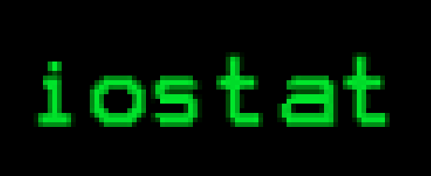

Testbed and benchmark configuration
Testbed (8 nodes):
Benchmarks:
Measurement Tools:
[1] “dstat,” https://dag.wiee.rs/home-made/dstat.
[2] “iostat,” https://linux.die.net/man/1/iostat.
[3] “blktrace,” https://linux.die.net/man/8/blktrace.
Notes:
We show the testbed and benchmark information in these two tables.
We have 8 nodes to run the experiments. Vmware workstation 12.5.
We run three representative types of applications (ML, GC and SQL queries).
We use open source tools like dstat, istat and blktrace to measure performance.
%Notice that machine learning algorithms and some graph computation algorithms are iterative in nature.
% and their execution time can thus be determined by the number of iterations.
%We also conduct sensitivity analysis of these applications under different number of iterations.

Slide 15
Study of Execution Time
Spark applications on Docker containers perform mostly better:
Faster startup time
Faster instance launch
Faster read operation (Docker supports COW)
Notes:
We first study the total execution time results.
The lower the better.
We see that spark on docker performs mostly better.
Because, the container has faster startup time, application instances are launched faster, and the read operations consumes less time due to intermediate storage driver layer of Docker which supports COW.
%Same versions: Kernel, Ubuntu, Spark, Hadoop
%Same resource allocation: number of cores, memory capacity

Slide 16
Sensitivity Analysis
10x
(a) PageRank
(b) Logistic Regression
(c) K-Means
Low shuffle degree
Middle shuffle degree
High shuffle degree
Different improvement for applications with different iterations and shuffle degrees. (a:10x, b:same, c:worse)
K-Means is the most “shuffle-intensive” => triggers lot of I/Os for RDD shuffles => COW for every write slows down Docker
Notes:
We further conduct sensitivity analysis to figure out why Kmeans performs worse in Docker.
We run PR, LR and KM for multiple numbers of iterations.
There are different performance improvement for different apps.
One is 10x very good, one is same, one is worst,
PR: the gap between VM and Docker can be 10x.
This is because that for each iteration, PageRank in Spark has a high reuse factor of two particular RDDs, which are persisted by Docker storage driver and thus can be quickly reused from main memory.
While LR and KM have lots of shuffles. especially when the number of clusters is relatively high.
Higher the shuffle degree is, more I/O will be triggered in between memory and disk, which slows down the Docker since Docker file system has to perform copy-on-write (COW) for every write operation.
% unlike those in-memory operations (e.g., map, reduce, join, etc.), the shuffle operation is more expensive in Spark, since it involves cross-executor broadcastings and longer time due to corresponding disk I/Os, data serializations, and network traffics.
% Specifically, higher value of K means that it needs to categorize the input data into more number of clusters.
% This further increases the shuffle selectivity of Kmeans because for each data point the number of labeling options increases and the distance of each data point from all cluster centroids needs to be fetched every iteration.
We analyzed these I/Os and found that the number of “writes” is larger while performing shuffle.
The Docker file system (i.e., AUFS) performs copy-on-write (COW) for every write operation.
During shuffle, many COW operations are triggered in Docker which may lead to a throttling stall of operating threads.
This dramatically reduces the benefits brought by Docker, and slows down the performance compared to VM.
Thus, we conclude that it is advisable to use VM rather than Docker for shuffle intensive applications in Spark.
We also verified this observation by experimenting with some other shuffle intensive applications such as Bigram, TeraSort. The results have the similar trends as those from K-Means.
%This is because for each iteration, PageRank in Spark has a high reuse factor of two particular RDDs, which are persisted by Docker storage driver and thus can be quickly retrieved from main memory.

Slide 17
System Resource Utilization
(a) CPU
(b) Disk
(c) Memory
Docker has much higher CPU utilization ratios compared to VM
I/Os are served from memory
Docker bypasses the guest OS so it demands less memory.
Notes:
Finally, we investigate the utilization of different system resources when running various benchmarks on VM or Docker
frameworks.
# CPU: Higher the better
Docker has much higher CPU utilization ratios compared to VM which means that Docker can use CPU resources more efficiently.
# Disk: Higher the better
Docker’s disk utilization ratios are also slightly higher than those of VMs for most applications.
Interestingly, the K-means (KM) application is an exception, as explained in the last slide.
# Notice that unlike the CPU, Disk utilization is calculated by dividing the used BW by the BW capacity only for these period that the disk is being used, so although KM uses Disk for long time, but the BW utilization ratio is low.
# Memory: Lower the better
Docker has lower memory utilization ratios compared to VM across all applications. The reason is that Docker bypasses the guest OS so it demands less memory.

Slide 18
Topics
1. Introduction
2. Virtualization Frameworks
3. Data Processing Engine
4. Evaluation
5. Conclusions and Future Work

Slide 19
Conclusion and Future Work
Built and evaluated end-to-end software stack for different virtualization framework for Spark application.
Investigated impacts on various Spark application:
  Latency
  Resource utilization
Concluded:
  Docker: map and calculation-intensive applications
  VM: shuffle-intensive applications
Future Work: Develop smart hybrid virtualization environment to support automatic best choice determination based on Spark application DAG.
Notes:
Docker for map and reduce calculation-intensive applications,
because Docker provides lightweight operation, copy-on-write (COW) and intermediate storage drivers that assist Spark applications to perform better.
For shuffle intensive applications, traditional VM hypervisor may perform better.
Our work can guide application developers, system administrators and researchers to better design and deploy big data applications on their platforms to improve the overall performance.

Slide 20
Thanks
Q & A
Q & A
21st IEEE High Performance Extreme Computing Conference

